Slide 1
Basic Psychosocial Skills +
A short course for frontline workers in Myanmar
Notes:
This short course on Basic Psychosocial Skills was developed for people who are providing frontline services in Myanmar.

Slide 2
This course is an adaptation of the online course “Basic Psychosocial Skills: a short course for First Responders in Sri Lanka” produced by The Asia Foundation and The Good Practice Group, with support from the Lotus Circle. The content for the Sri Lanka course (https://psychosocialskills.teachable.com/) was adapted from the Inter-Agency Standing Committee publication “Basic Psychosocial Skills: A Guide for COVID-19 Responders”.
This translation/adaptation was not created by the Inter-Agency Standing Committee (IASC). The IASC is not responsible for the content or accuracy of this translation/adaptation. Additional material has been included in this adaptation. The original English edition ‘Inter-Agency Standing Committee. Basic Psychosocial Skills: A Guide for COVID-19 Responders.’ published in 2020, shall be the binding and authentic edition: https://app.mhpss.net/resource/basic-psychosocial-skills-a-guide-for-covid-19-responders
This translation/adaptation is published under the same license as the original publication and the subsequent adaptation: CC BY-NC-SA 3.0 IGO (https://creativecommons.org/licenses/by-nc-sa/3.0/)
Pictures included in this training have been provided by UNFPA Myanmar
Notes:
This course is an adaptation of the online course “Basic Psychosocial Skills: a short course for First Responders in Sri Lanka” produced by The Asia Foundation and The Good Practice Group, with support from the Lotus Circle. The content for the Sri Lanka course (https://psychosocialskills.teachable.com/) was adapted from the Inter-Agency Standing Committee publication “Basic Psychosocial Skills: A Guide for COVID-19 Responders”.
This translation/adaptation was not created by the Inter-Agency Standing Committee (IASC). The IASC is not responsible for the content or accuracy of this translation/adaptation. Additional material has been included in this adaptation. The original English edition ‘Inter-Agency Standing Committee. Basic Psychosocial Skills: A Guide for COVID-19 Responders.’ published in 2020, shall be the binding and authentic edition: https://app.mhpss.net/resource/basic-psychosocial-skills-a-guide-for-covid-19-responders
This translation/adaptation is published under the same license as the original publication and the subsequent adaptation: CC BY-NC-SA 3.0 IGO (https://creativecommons.org/licenses/by-nc-sa/3.0/)
Pictures included in this training have been provided by UNFPA Myanmar

Slide 3
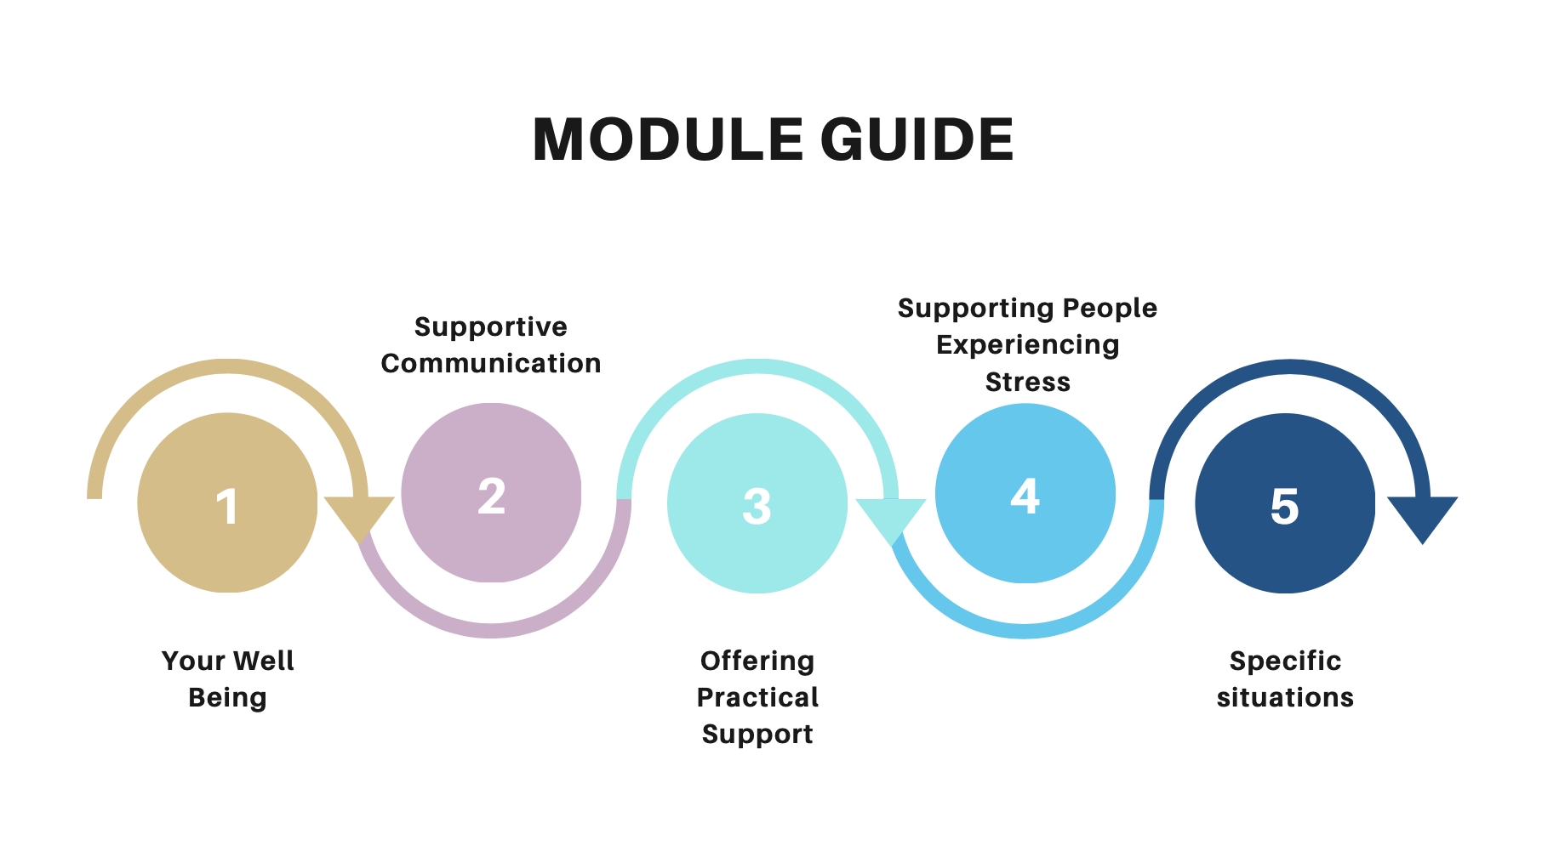
Notes:
Module Guide: This course consists of five modules including topics such as, Your Wellbeing, Supportive Communication in Everyday Interactions, Offering Practical Support, Supporting People who are Experiencing Stress and Helping People in Specific Situations.
Topics explored in this course are primarily designed to support first responders in any crisis as the skills discussed are derived from basic community based support.

Slide 4
Module 5
5.1 Helping people in specific situations : Recognizing vulnerable people in need
Notes:
Hello and welcome to the fifth and final module of Basic Psychosocial Skills for frontline workers. In this module we will be discussing ‘Helping People in Specific Situations’. We will look at what are specific situations in a crisis and how people in such situations can be helped by you.

Slide 5
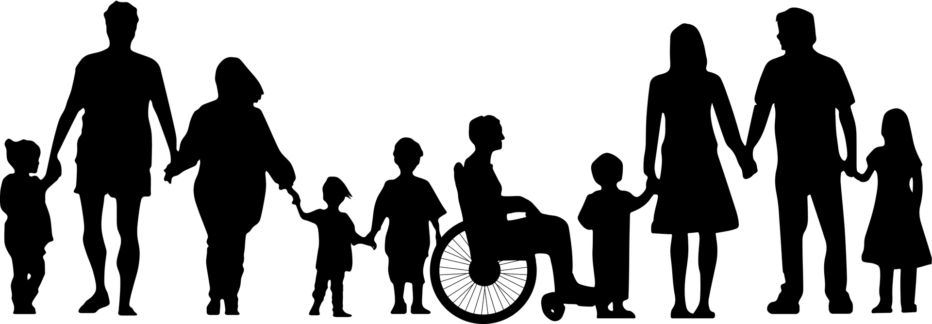
Helping people in specific situations
Notes:
Reasons to help people in specific situations

Slide 6
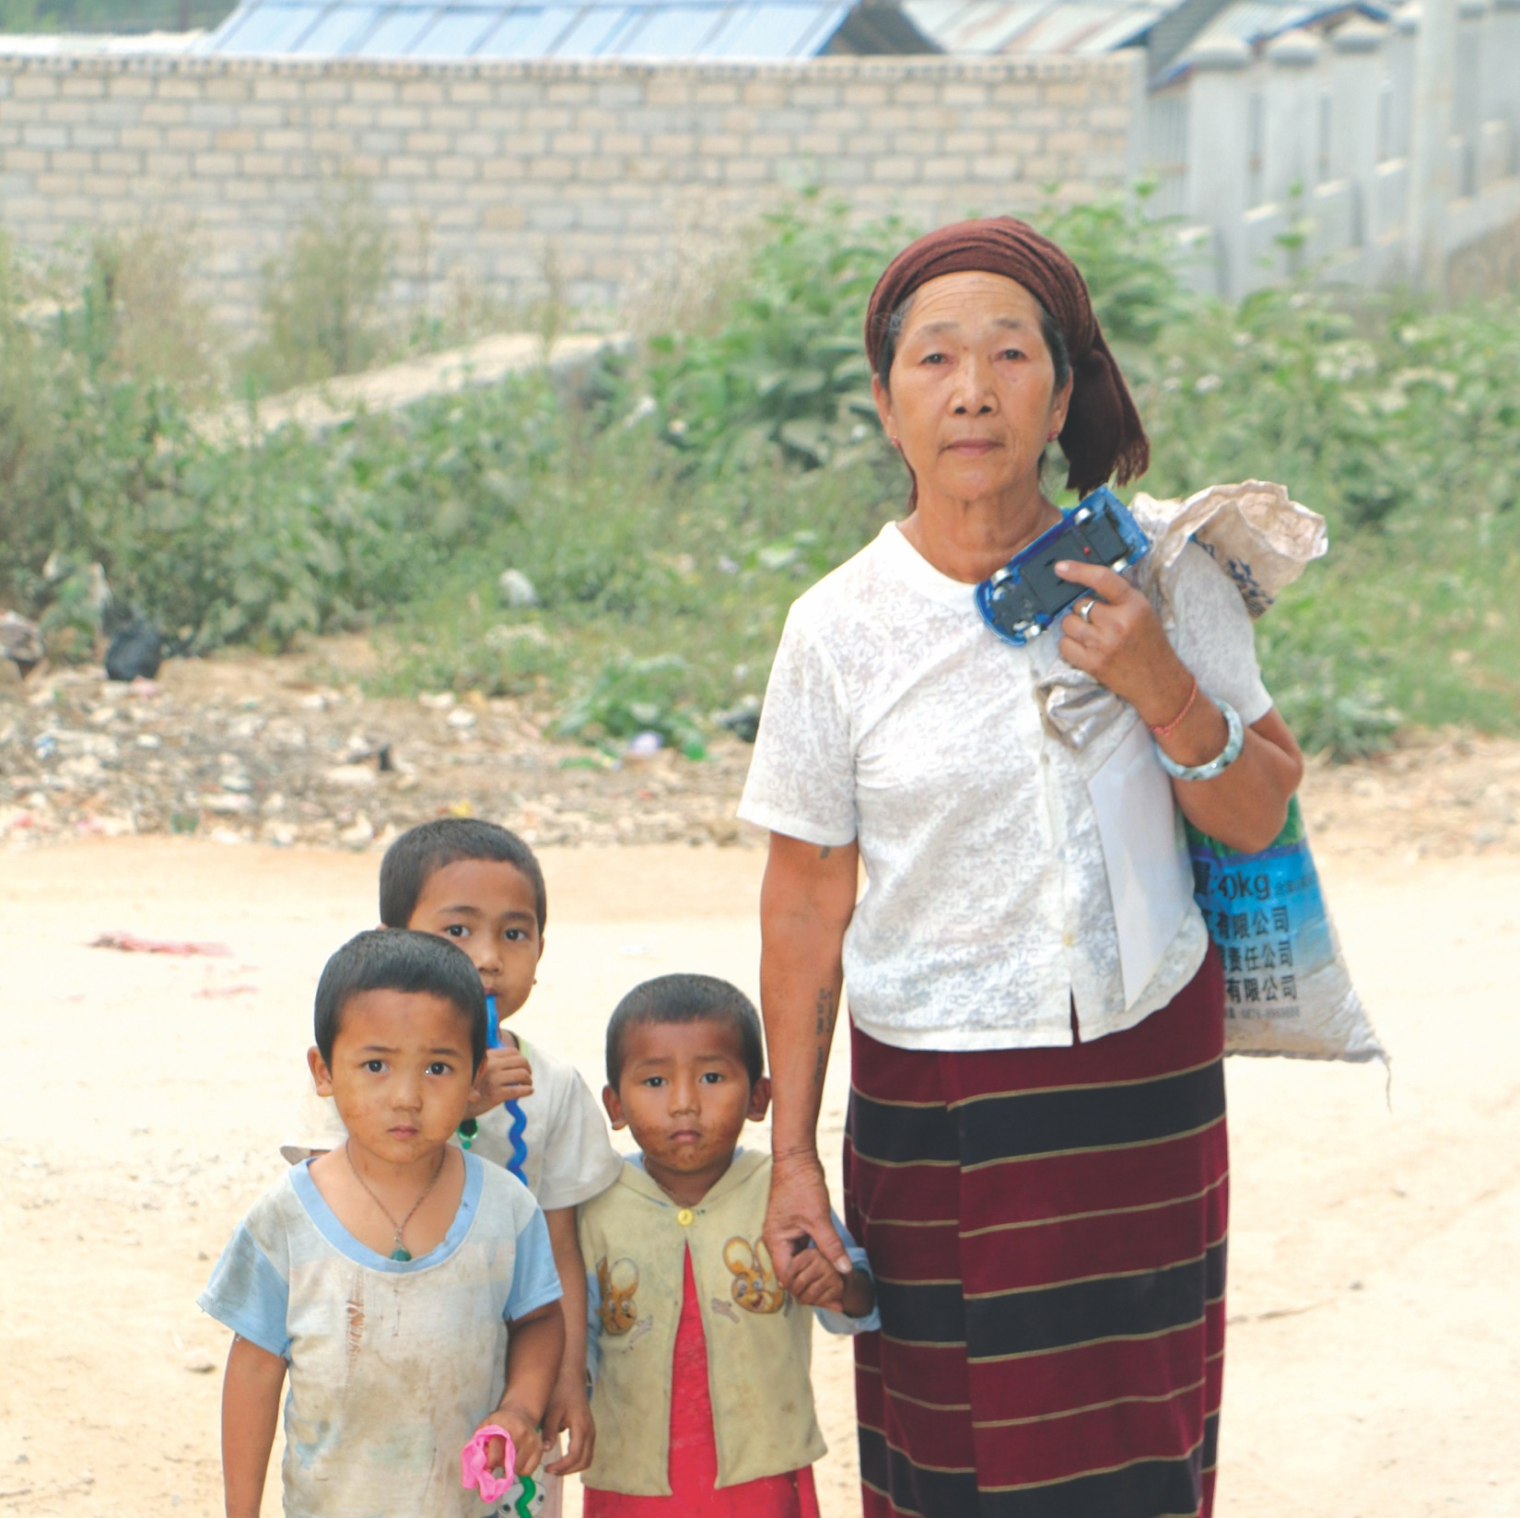
Anyone who is more vulnerable or at risk to distress in the general population need to be considered as people in specific situations.
Notes:
Anyone who is more vulnerable or at risk to distress in the general population need to be considered as people in specific situations.

Slide 7
Make sure that people in vulnerable or marginalized situations are not overlooked
Notes:
Make sure as a helper that people in vulnerable or marginalized situations in are not overlooked.

Slide 8
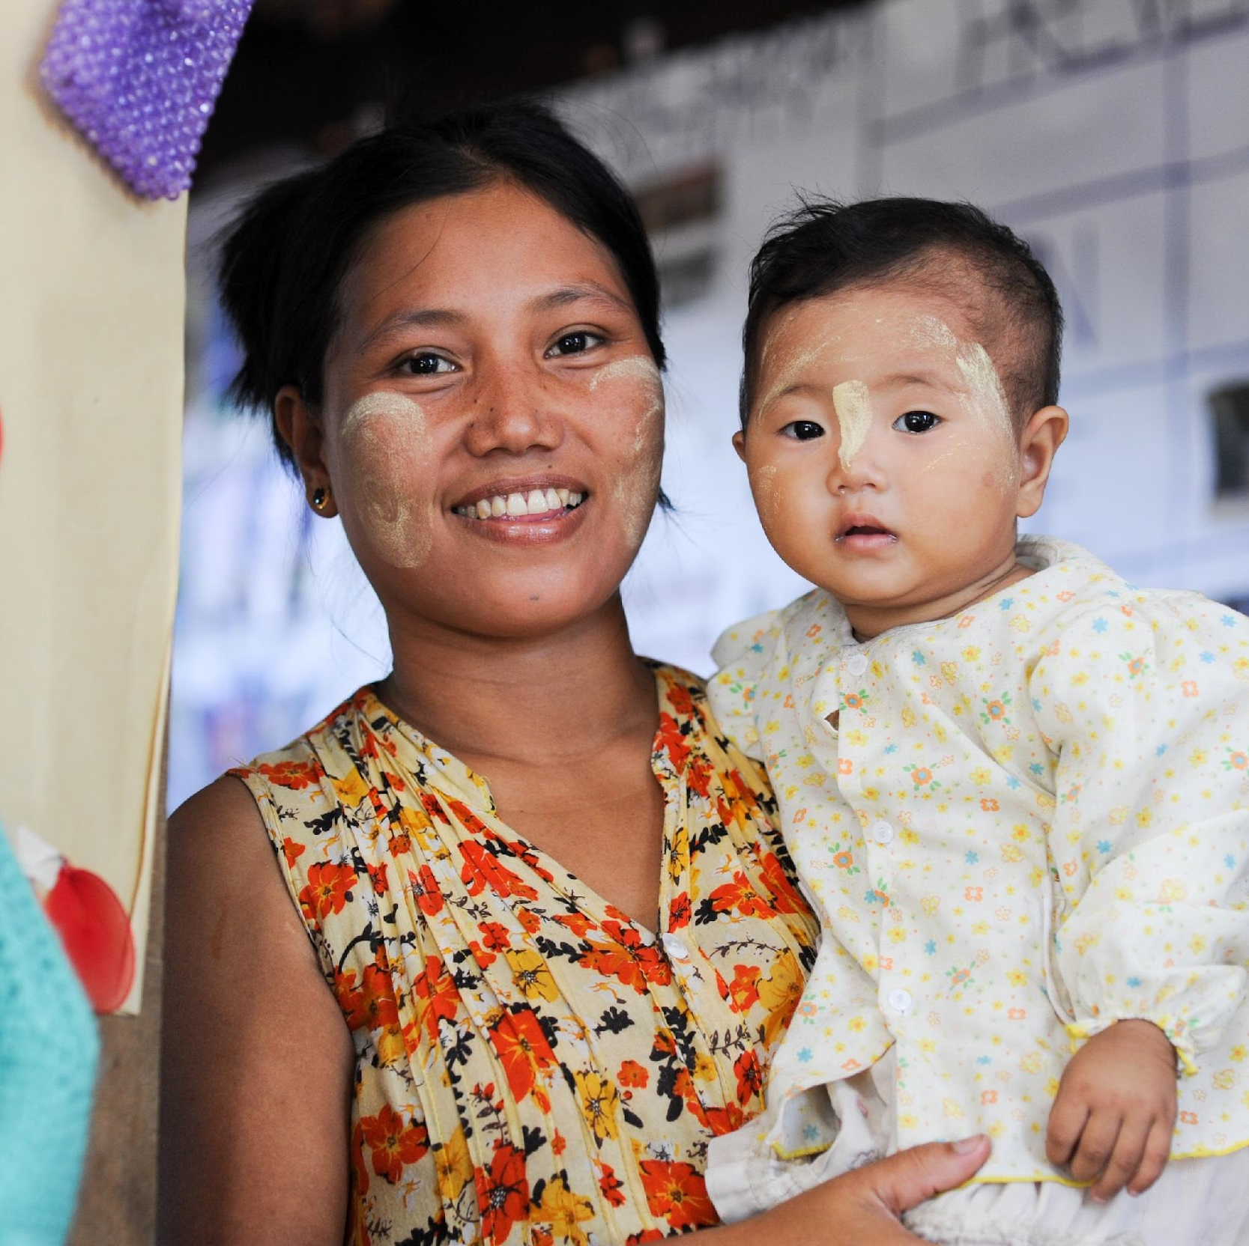
People in vulnerable situations will likely need special attention during a crisis
Notes:
Especially during a crisis, like the COVID-19 pandemic, people in vulnerable situations will likely need special attention.

Slide 9
Not all vulnerabilities will be visible or obvious, so it is important to respond in a caring and empathetic way to everyone you encounter
Notes:
Sometimes, not all vulnerabilities will be visible or obvious, so it is important to respond in a caring and empathetic way to everyone you encounter

Slide 10
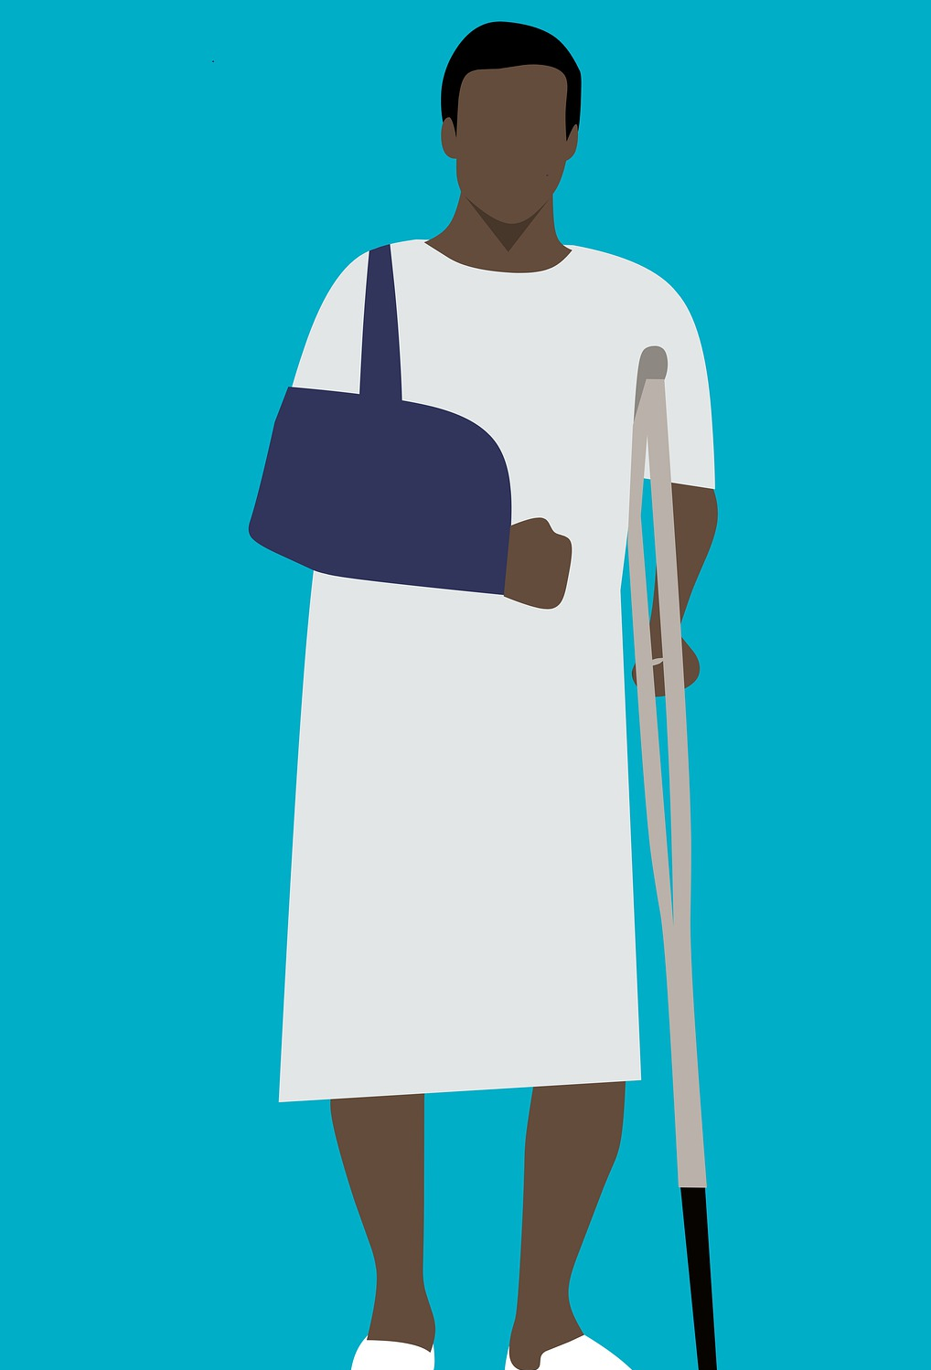
Anyone can be in a vulnerable or in a marginalized situation at different points in their lives.
Notes:
Anyone can be in a vulnerable or in a marginalized situation at different points in their lives.

Slide 11
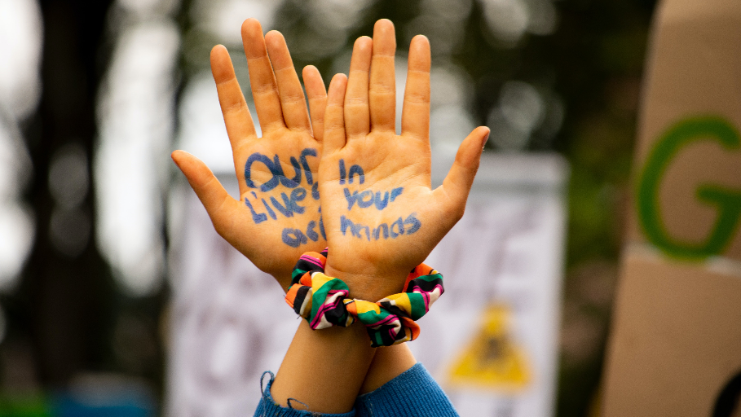
Some people, based on the barriers, bias and stigma associated with specific aspects of their identity, will face these situations more often and with more severity.
Notes:
Some people, based on the barriers, bias and stigma associated with specific aspects of their identity, will face these situations more often and with more severity.

Slide 12
Module 5
5.2 Vulnerable Groups
Notes:
Let us look at some identified vulnerable groups

Slide 13
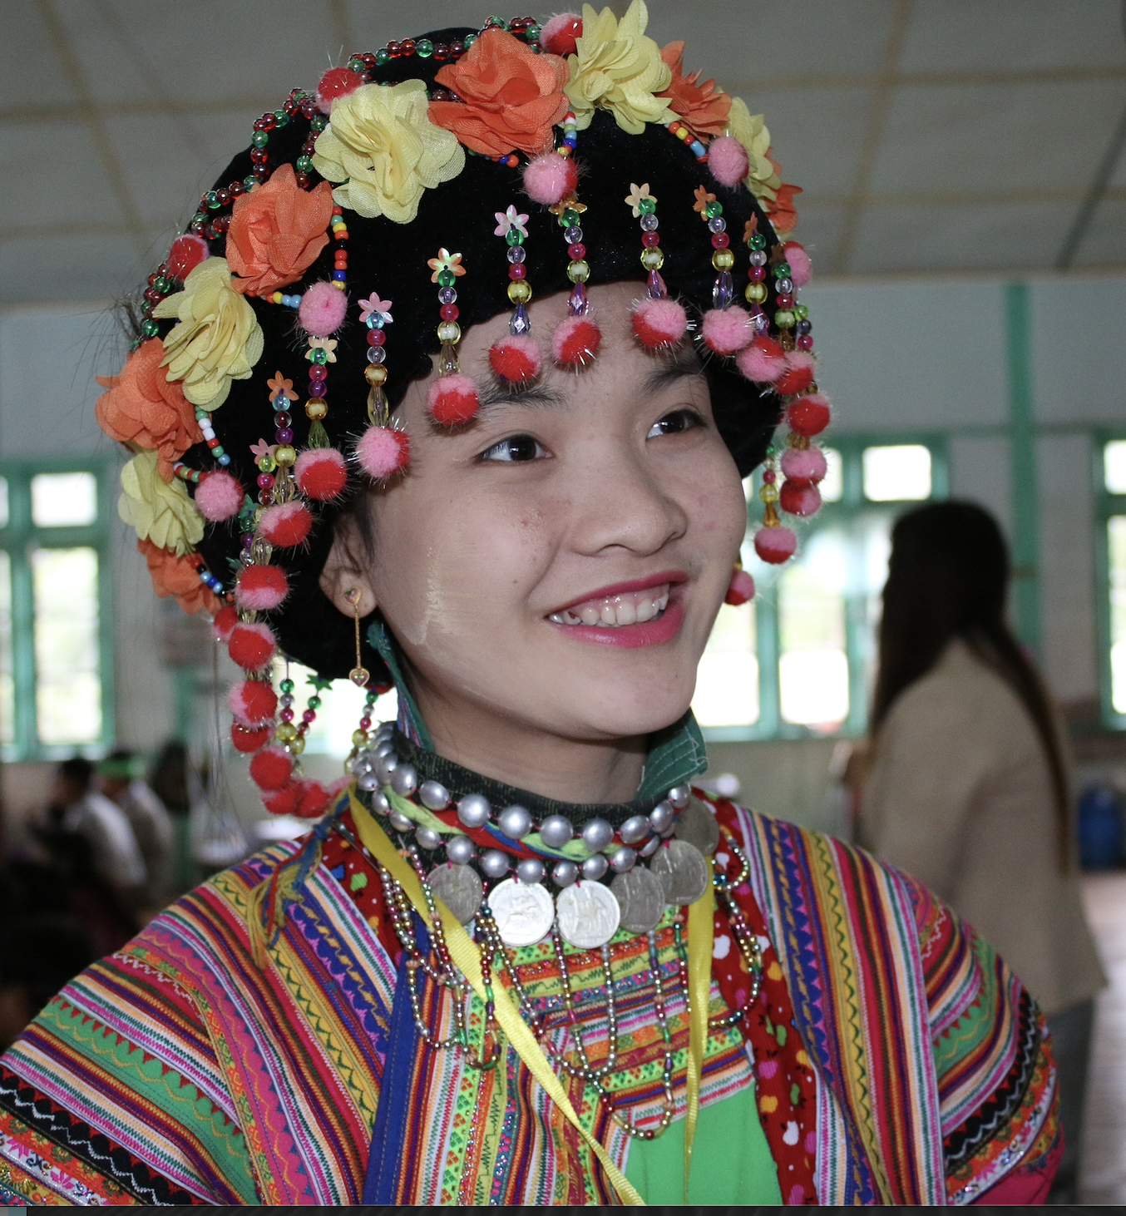
Marginalized Persons and Groups
Ethnic minorities, less represented working class (sex workers), economically underprivileged, individuals who don’t speak the majority language may experience challenges in accessing services or denied of services due to their social belonging and social biases
Notes:
Marginalised persons and groups- Ethnic minorities, less represented working class, economically underprivileged, individuals who don’t speak the majority language may experience challenges in accessing services or denied of services due to their social belonging and social biases

Slide 14
Survivors of Gender-based Violence
People experiencing gender-based violence, including intimate partner violence, which may escalate during times of crisis. Women and Children who can be prone to abuse and neglect during crisis situations.
Notes:
VICTIMS OF DOMESTIC OR GENDER-BASED VIOLENCE-
People experiencing gender-based violence and/or intimate partner violence, which may escalate during crisis. Women and Children who can be prone to abuse and neglect within crisis situations.

Slide 15
THE LGBTQI Community
People less represented in the community due to their sexual/gender identity may have difficulty accessing basic needs due to social stigma and biases.
They may also be denied of services due to their identity.
Notes:
LGBTQI Community-
People less represented in the community due to their sexual/gender identity may have difficulty accessing basic needs due to social stigma and biases.
They may also be denied of services due to their identity

Slide 16
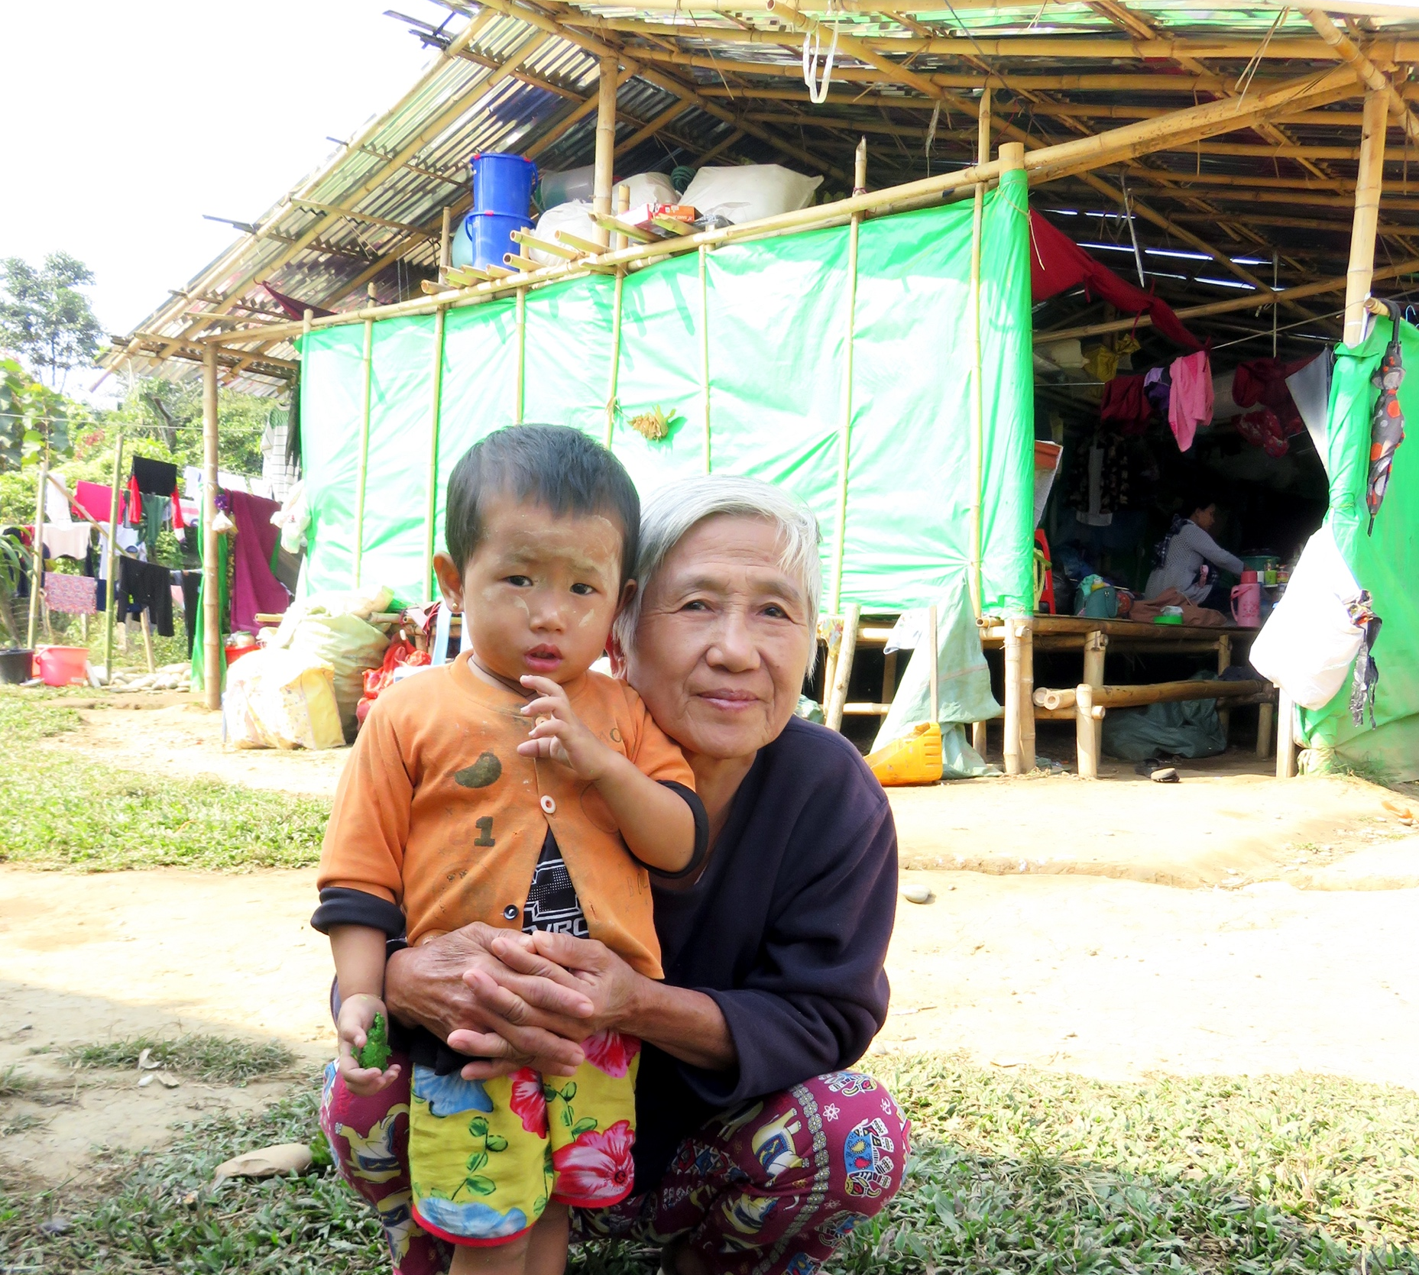
Migrants & Refugees
Persons from other countries who are in your country for safety and shelter due to the threat they faced in their homeland.
These people may not have access to all legal services due to their national status, therefore they are also prone to social exclusion and denial of basic services.
Notes:
Migrants/ Refugees-
Persons from other countries who are in your country for safety and shelter due to the threat they faced in their homeland.
These people may not have access to all legal services due to their national status, therefore they are also prone to social exclusion and denial of basic services.

Slide 17
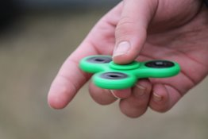
People with special needs including mental health conditions and psychosocial disabilities
Persons with special needs may have an interruption in their additional support (medication, human assistance and etc), this may disrupt their functioning.
Notes:
PEOPLE WITH SPECIAL NEEDS, INCLUDING MENTAL HEALTH CONDITIONS AND PSYCHOSOCIAL DISABILITIES-
Persons with special needs may have an interruption in their additional support (medication, human assistance and etc), this may disrupt their functioning.

Slide 18
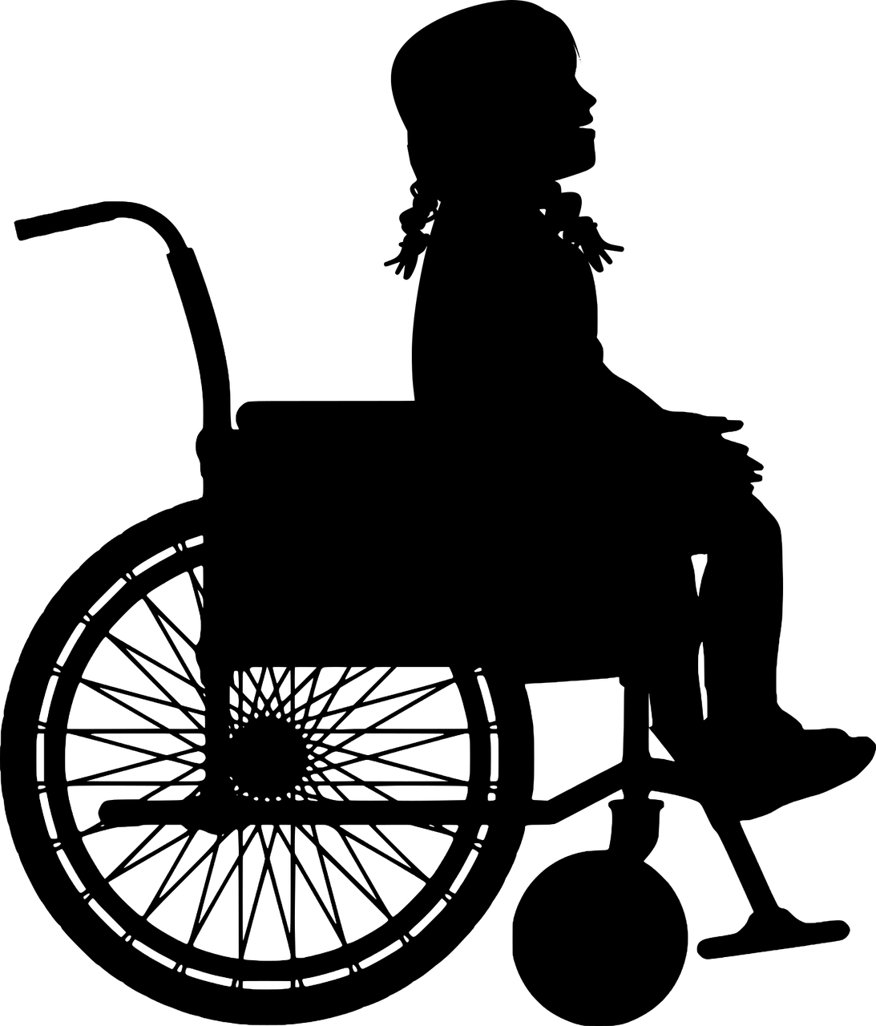
People with physical disabilities
People with physical impairments, who need specialized care and services may have accessibility issues (eg: physical accessibility as well as information accessibility if one is hearing or visually impaired.)
Notes:
PEOPLE WITH PHYSICAL DISABILITIES-
People with physical impairments, who need specialized care and services may have accessibility issues (eg: physical accessibility as well as information accessibility if one is hearing or visually impaired.)

Slide 19
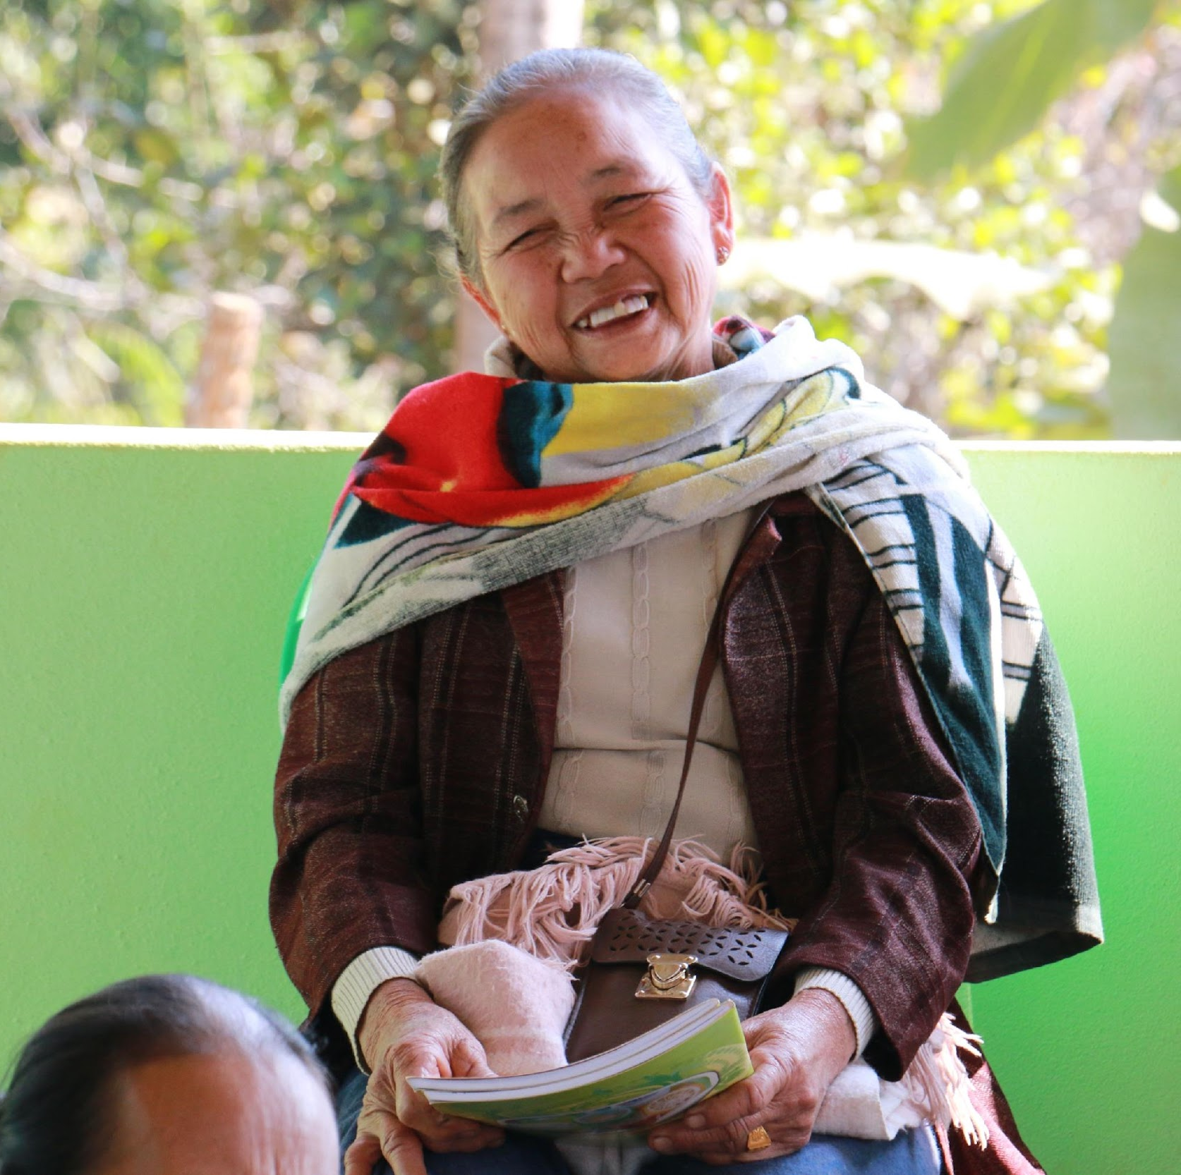
People living in care homes
Individuals living in care homes may feel helpless and lost as they need to stay in the care homes (elder home, children care homes, probations centers and etc) as they might not have external support. They may experience severe distress of feeling confused and being disconnected from the outside world
Notes:
PEOPLE LIVING IN CARE HOMES- Individuals living in care homes may feel helpless and lost as they need to stay in the care homes (elder home, children care homes, probations centers and etc) as they might not have external support. They may experience severe distress of feeling confused and being disconnected from the outside world

Slide 20
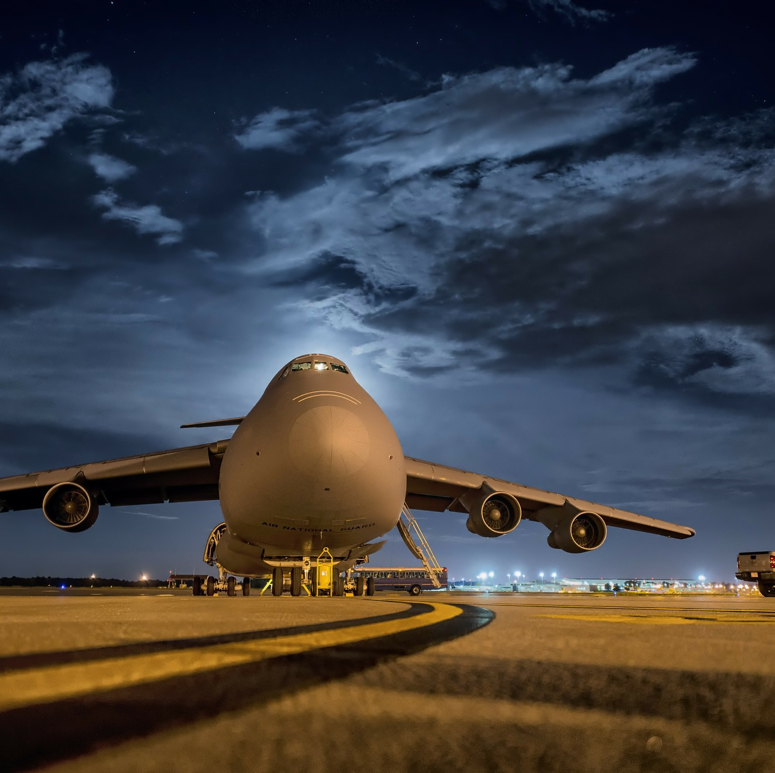
Returnees from abroad (migrant workers, students and other individuals)
Individuals who return from abroad may face discrimination due to the stigma prevailing on foreign returnees. They may also experience distress while being sent to quarantine and may lack access to communication with their families and loved ones
Notes:
RETURNEES FROM ABROAD (MIGRANT WORKERS, STUDENTS AND OTHER INDIVIDUALS)
Individuals who return from abroad may face discrimination due to the stigma prevailing on foreign returnees. They may also experience distress while being sent to quarantine and may lack access to communication with their families and loved ones

Slide 21
People who are 'suspected' of having COVID-19/ recovered from COVID-19
Individuals who are sent to quarantine centres and individuals tested positive may face stigma in the communities and this will result in increased distress among individuals.
Notes:
PEOPLE WHO ARE ‘SUSPECTED’ OF HAVING COVID-19/ RECOVERED FROM COVID-19
Individuals who are sent to quarantine centres and individuals tested positive may face stigma in the communities and this will result in increased distress among individuals.

Slide 22
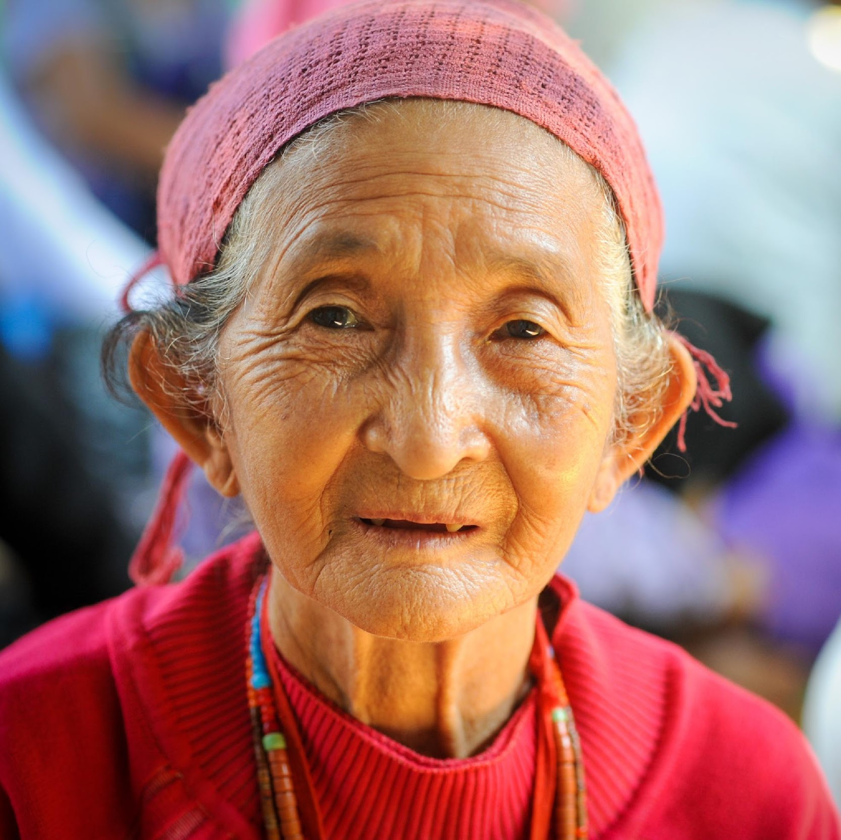
Older adults
Elderly persons who require medical assistance and who live alone are prone to more anxiety due to the nature of COVID-19 and also the ones who live alone may have feel overwhelmed with the movement restrictions limiting their social contacts.
Notes:
OLDER ADULTS- Elderly persons who require medical assistance and who live alone are prone to more anxiety due to the nature of COVID-19 and also the ones who live alone may have feel overwhelmed with the movement restrictions limiting their social contacts.

Slide 23
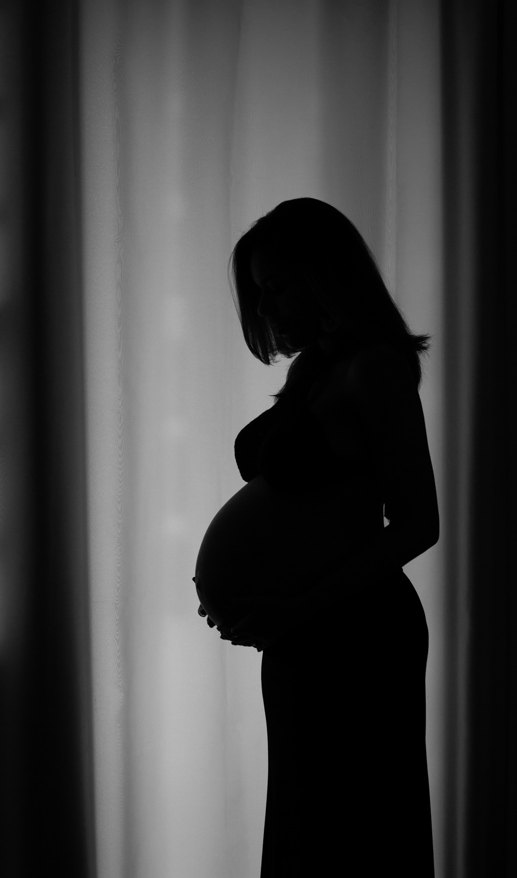
Pregnant women and people with chronic health conditions who need regular access to services
Individuals who regular medical assistance, would need additional support in accessing medical services. They may feel distressed and worried about their conditions getting worse and not being able to meet adequate medical assistance.
Notes:
PREGNANT WOMEN AND PEOPLE WITH CHRONIC HEALTH CONDITIONS WHO NEED REGULAR ACCESS TO SERVICES -
Individuals who regular medical assistance, would need additional support in accessing medical services. They may feel distressed and worried about their conditions getting worse and not being able to meet adequate medical assistance.

Slide 24
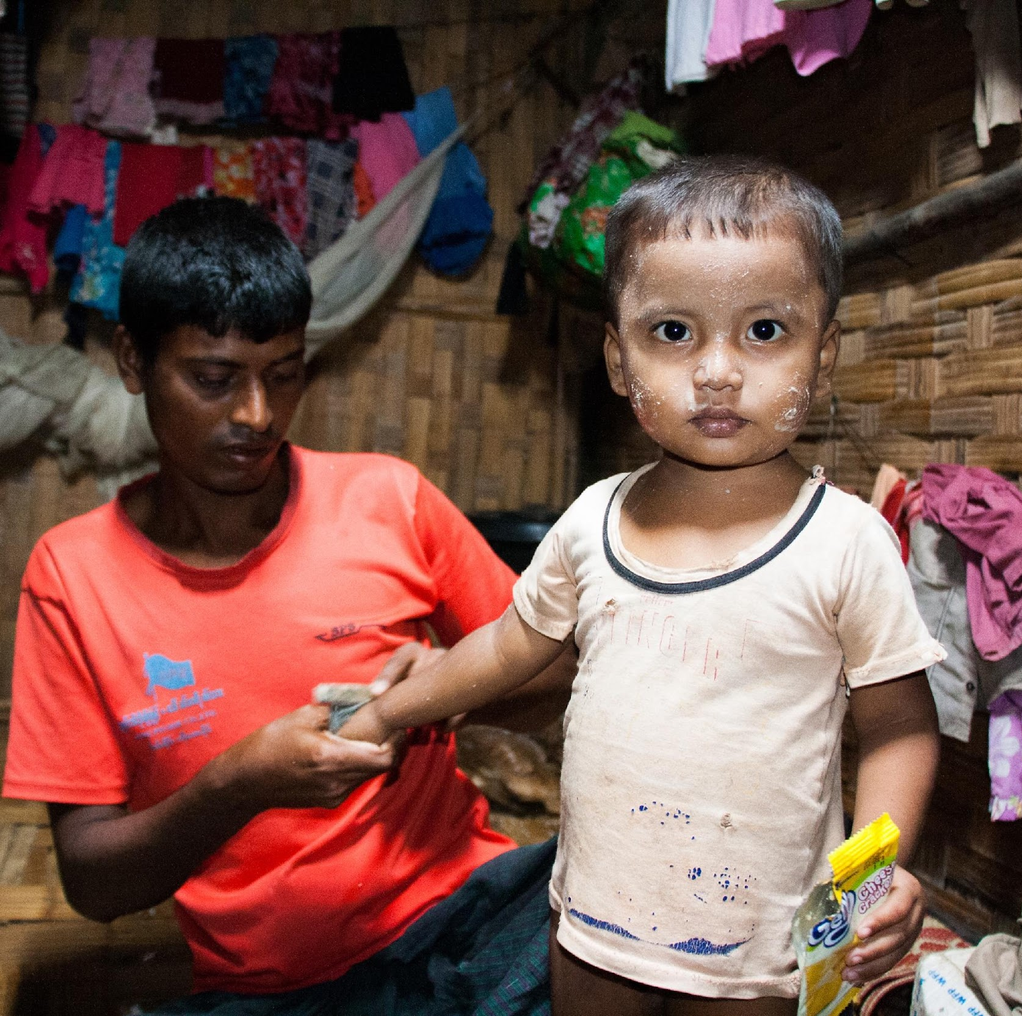
Children, adolescents and their caregivers
Children and adolescents are prone to increased amount of stress as they are deprived from going to the school and their routine being disrupted. This adds burden to their caregivers, which puts them in a vulnerable state of feeling overwhelmed and helpless.
Notes:
CHILDREN, ADOLESCENTS AND THEIR CAREGIVERS-
Children and adolescents are prone to increased amount of stress as they are deprived from going to the school and their routine being disrupted. This adds burden to their caregivers, which puts them in a vulnerable state of feeling overwhelmed and helpless.

Slide 25
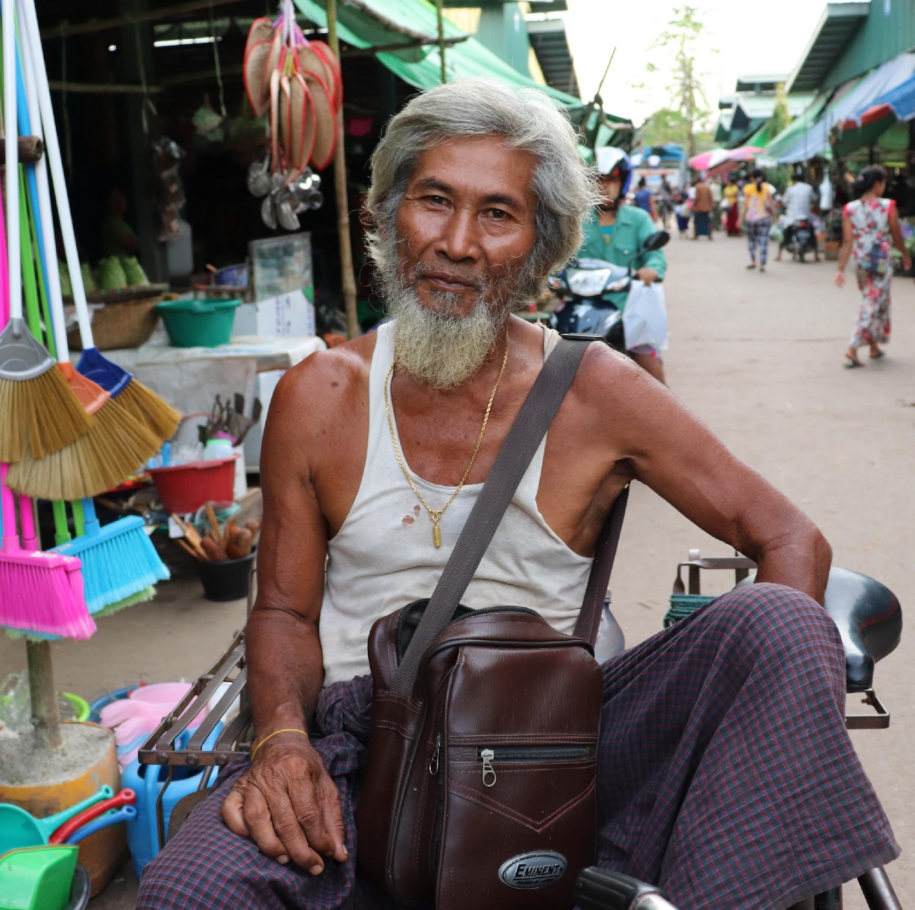
Those who are homeless
People who live on the streets and in illicit shelters are generally at a higher risk of being ignored by the community and deprived of livelihood support.
Notes:
THOSE WHO ARE HOMELESS -
People who live on the streets and in illicit shelters are generally at a higher risk of being ignored by the community and deprived of livelihood support.

Slide 26
People who are grieving
People may be unable to use their normal ways of coping with stress, such as seeking support from family members, or to continue their normal daily routines.
They may feel that their loss is not significant because so many people are being impacted by the crisis, and they may be unable to perform normal mourning rituals.
Notes:
PEOPLE WHO ARE GRIEVING-
People may be unable to use their normal ways of coping with stress, such as seeking support from family members, or to continue their normal daily routines.
They may feel that their loss is not significant because so many people are being impacted by the crisis, and they may be unable to perform normal mourning rituals.

Slide 27
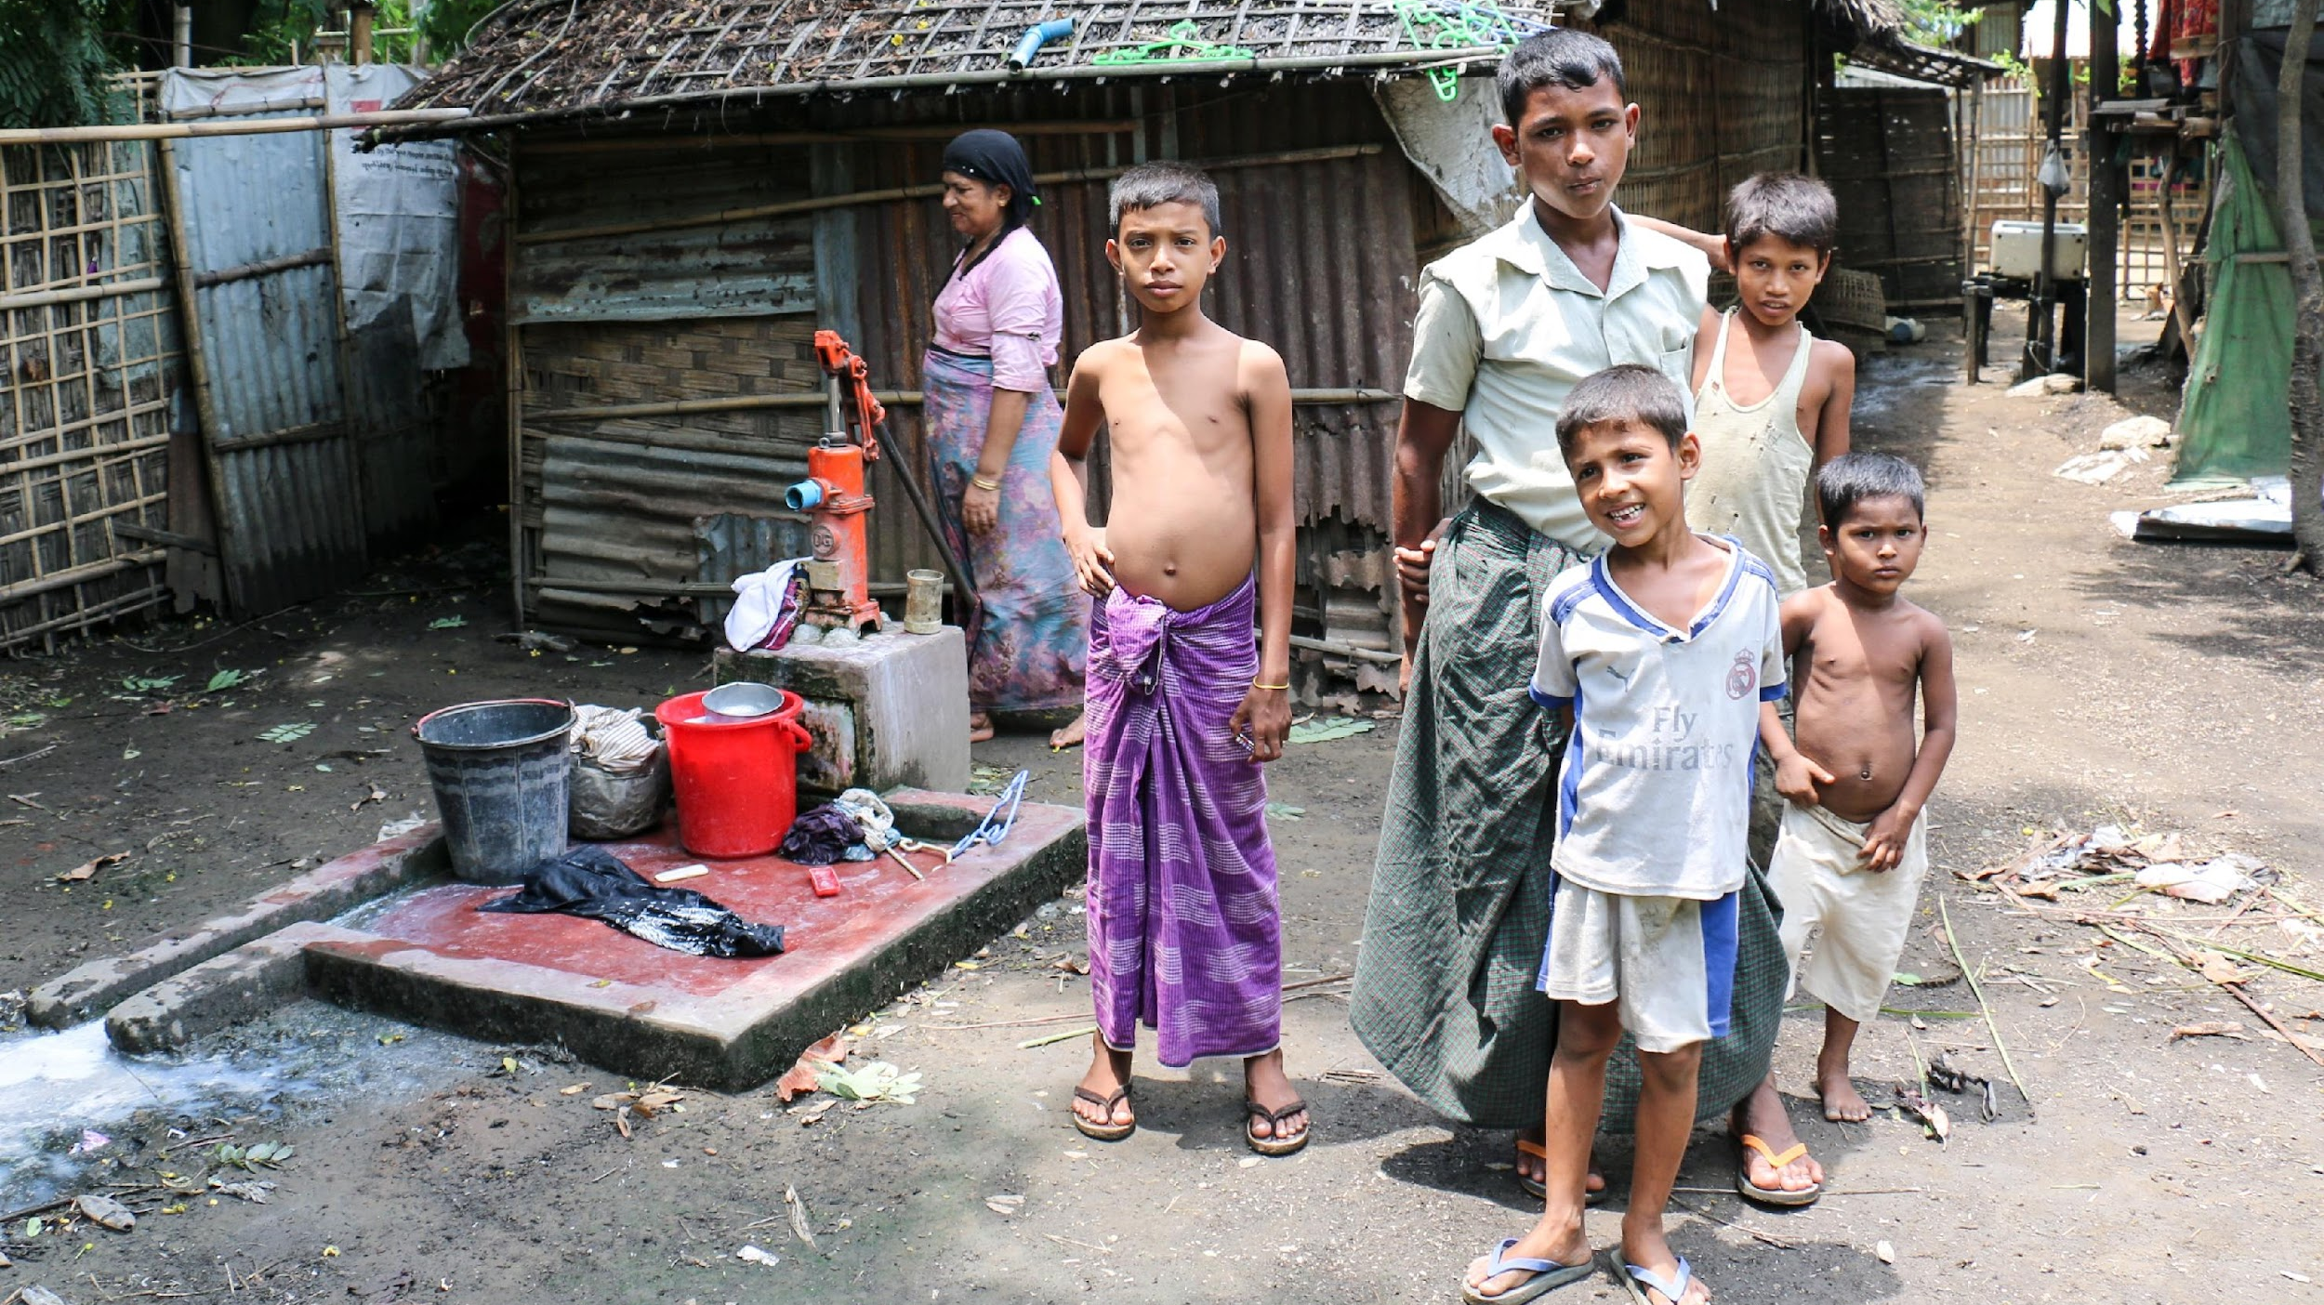
Those in crowded living conditions
People in these settings face challenges of not being able to follow rules on physical distancing due to crowded conditions; and experiencing human rights abuses from those enforcing movement restrictions
Notes:
THOSE IN CROWDED LIVING CONDITIONS
(e.g. prisoners, people in detention, refugees in camps and informal settlements, older adults in long-term care institutions, people in psychiatric hospitals, inpatient units or other institutions)
People in these settings face challenges of not being able to follow rules on physical distancing due to crowded conditions; and experiencing human rights abuses from those enforcing movement restrictions
These are a few of the specific situations in which people can be more vulnerable and need specific support

Slide 28
Module 5
5.3 Supporting vulnerable people
Notes:
Now let’s look at ways you can support when you meet someone who falls in the vulnerable groups

Slide 29
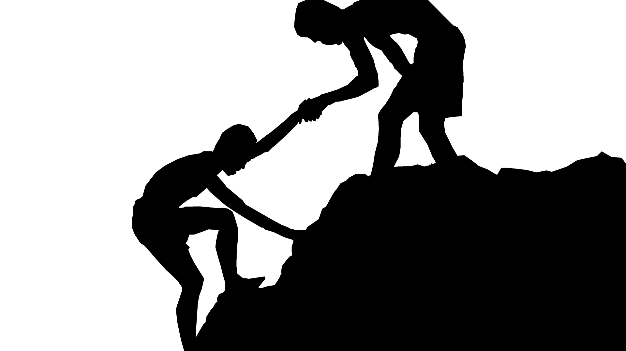
What to do when you meet someone who is vulnerable
Notes:
What to do when you meet someone who is vulnerable

Slide 30
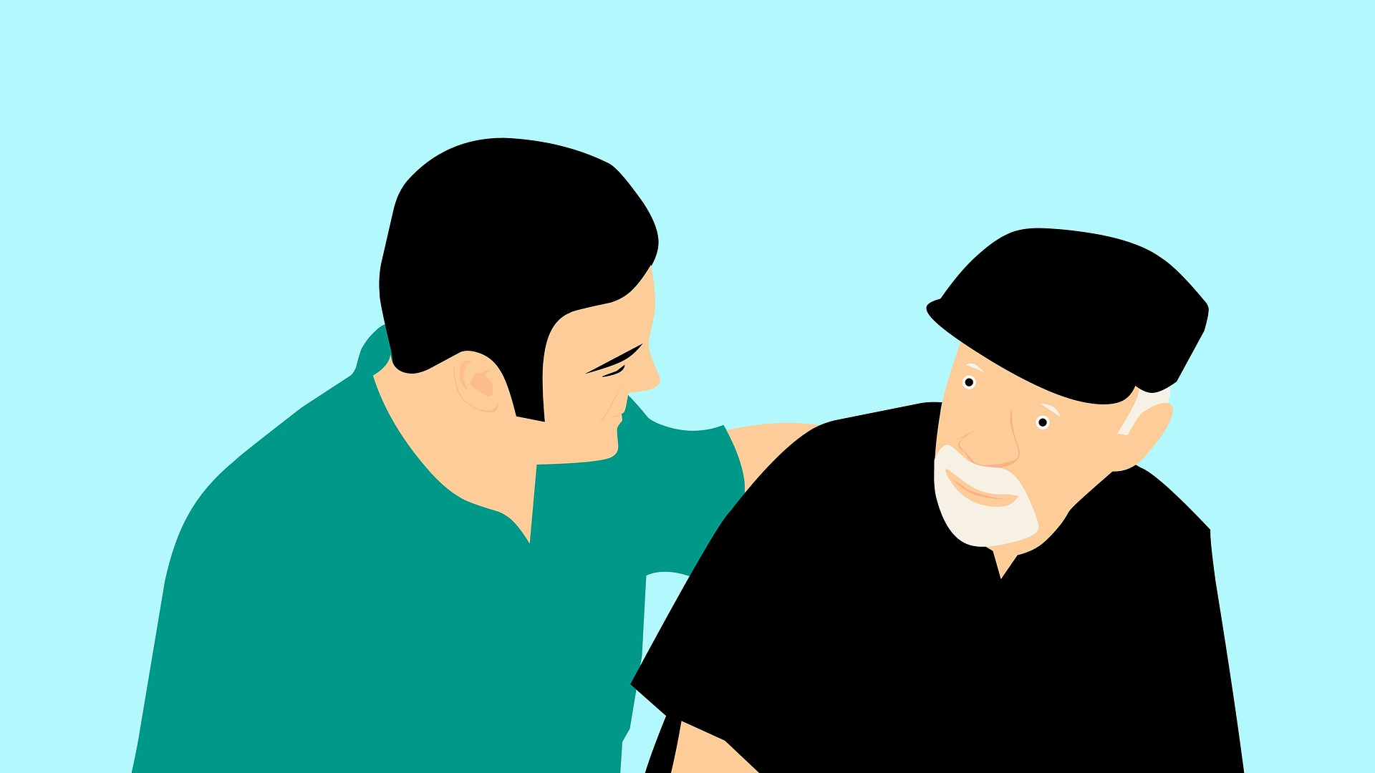
Apply the skills of supportive communication to show them your support
Notes:
First of all, always apply the skills of supportive communication to show the person who needs help your support.

Slide 31
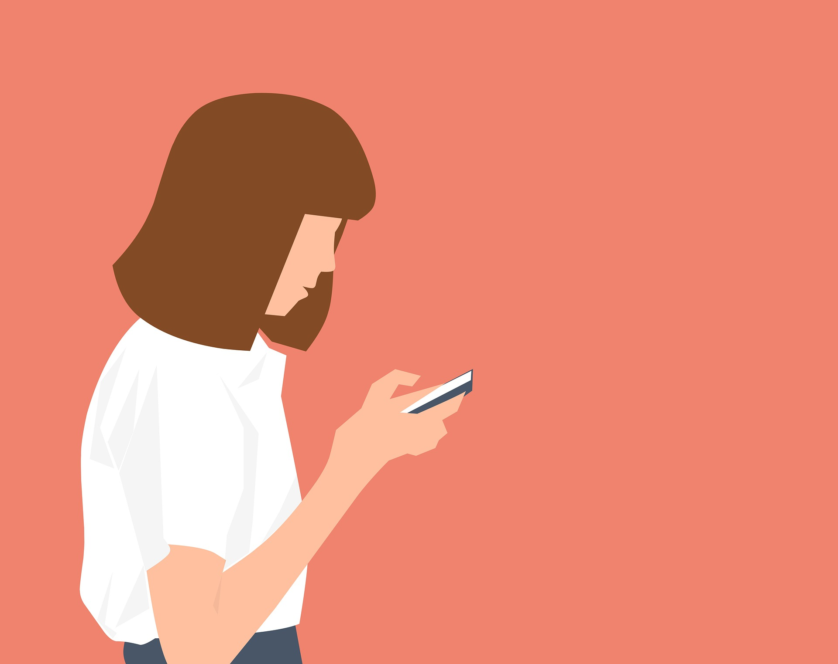
Gather knowledge about the specific group so that you can support them in a better way
Notes:
Then try your level best to gather knowledge about the specific group so that you can support them in a better way

Slide 32
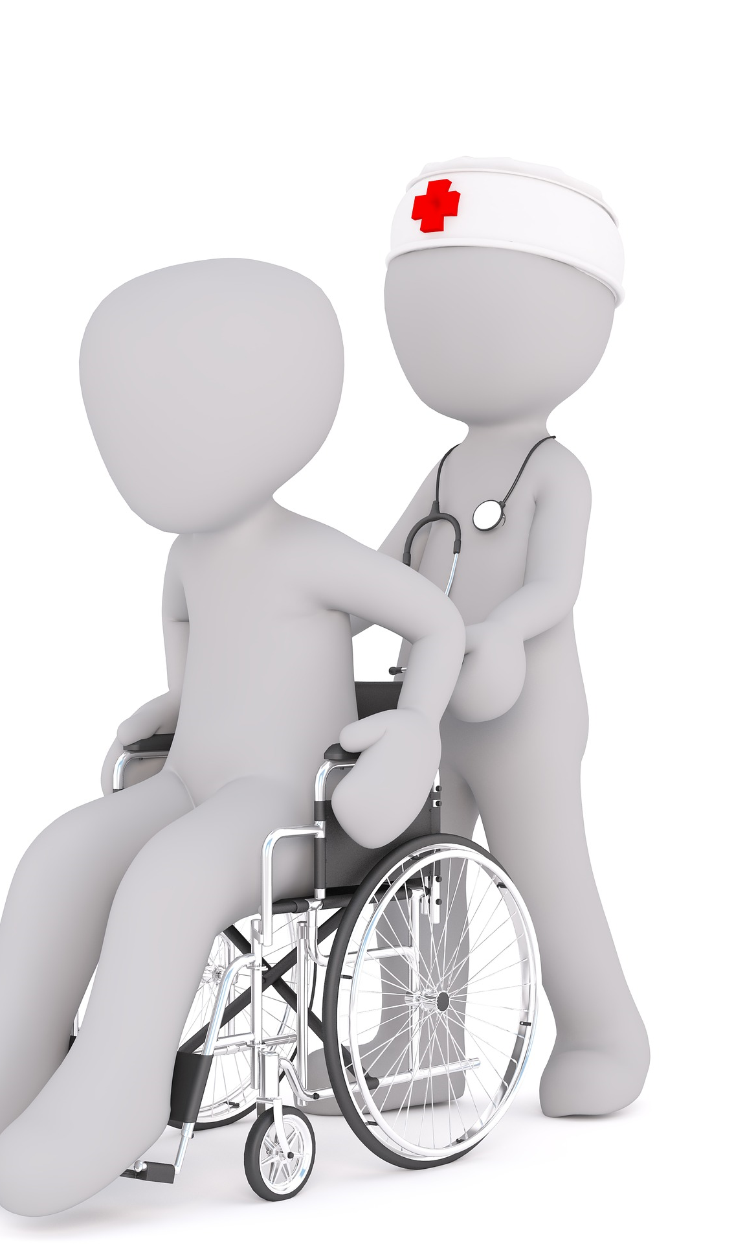
Identify support services for vulnerable groups in your area based on their specific needs and inform them of the available services
Notes:
Which is then followed by identifying support services for the vulnerable groups in your area based on their specific needs.

Slide 33
Refer them to organizations and individuals who have the skills and resources to help if they provide their informed consent.
Notes:
and finally referring them after they have provided their informed consent, by linking them with organizations that may have specialised knowledge and experience in supporting people with particular types of vulnerabilities and problems.
By following the aforementioned steps, you may provide practical support to people in specific situations.

Slide 34
Module 5 Complete
Next: Module 6
Notes:
In this module we discussed ‘Helping People in Specific Situations’. We looked at what are specific situations in a crisis and how people in such situations can be helped by you. We hope you have enjoyed this module.
Please take the evaluation for module 5 and then continue to module 6

