Slide 1
Basic Psychosocial Skills +
A short course for frontline workers in Myanmar
Notes:
This short course on Basic Psychosocial Skills was developed for people who are providing frontline services in Myanmar.

Slide 2
This course is an adaptation of the online course “Basic Psychosocial Skills: a short course for First Responders in Sri Lanka” produced by The Asia Foundation and The Good Practice Group, with support from the Lotus Circle. The content for the Sri Lanka course (https://psychosocialskills.teachable.com/) was adapted from the Inter-Agency Standing Committee publication “Basic Psychosocial Skills: A Guide for COVID-19 Responders”.
This translation/adaptation was not created by the Inter-Agency Standing Committee (IASC). The IASC is not responsible for the content or accuracy of this translation/adaptation. Additional material has been included in this adaptation. The original English edition ‘Inter-Agency Standing Committee. Basic Psychosocial Skills: A Guide for COVID-19 Responders.’ published in 2020, shall be the binding and authentic edition: https://app.mhpss.net/resource/basic-psychosocial-skills-a-guide-for-covid-19-responders
This translation/adaptation is published under the same license as the original publication and the subsequent adaptation: CC BY-NC-SA 3.0 IGO (https://creativecommons.org/licenses/by-nc-sa/3.0/)
Pictures included in this training have been provided by UNFPA Myanmar
Notes:
This course is an adaptation of the online course “Basic Psychosocial Skills: a short course for First Responders in Sri Lanka” produced by The Asia Foundation and The Good Practice Group, with support from the Lotus Circle. The content for the Sri Lanka course (https://psychosocialskills.teachable.com/) was adapted from the Inter-Agency Standing Committee publication “Basic Psychosocial Skills: A Guide for COVID-19 Responders”.
This translation/adaptation was not created by the Inter-Agency Standing Committee (IASC). The IASC is not responsible for the content or accuracy of this translation/adaptation. Additional material has been included in this adaptation. The original English edition ‘Inter-Agency Standing Committee. Basic Psychosocial Skills: A Guide for COVID-19 Responders.’ published in 2020, shall be the binding and authentic edition: https://app.mhpss.net/resource/basic-psychosocial-skills-a-guide-for-covid-19-responders
This translation/adaptation is published under the same license as the original publication and the subsequent adaptation: CC BY-NC-SA 3.0 IGO (https://creativecommons.org/licenses/by-nc-sa/3.0/)
Pictures included in this training have been provided by UNFPA Myanmar

Slide 3
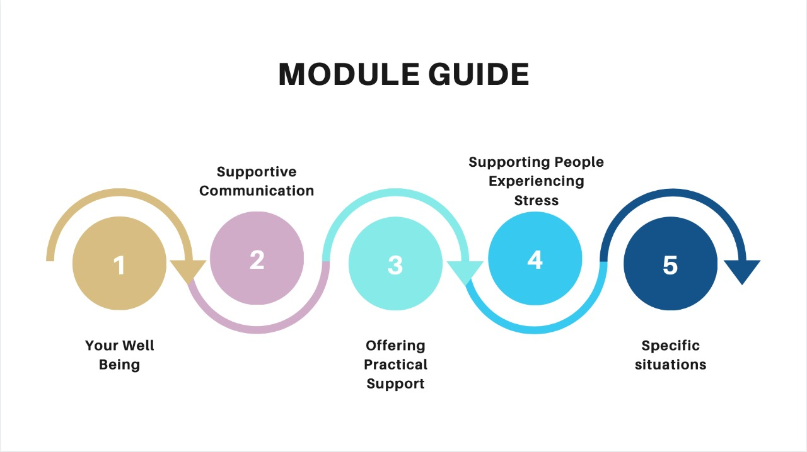
Notes:
This course consists of five modules: Your Wellbeing, Supportive Communication in Everyday Interactions, Offering Practical Support, Supporting People who are Experiencing Stress and Helping People in Specific Situations.
The topics explored in these modules are primarily designed to support frontline workers as these skills can also applied to community and personal crisis situations.

Slide 4
Module 3
Offering Practical Support
3.1 Providing information and basic items
Notes:
Welcome to the third module of Basic Psychosocial Skills for frontline workers. In this module we will be discussing ‘Offering Practical Support’. We will look at what kinds of needs people will have during a crisis situation and how you can offer practical support as a frontline worker.

Slide 5
PEOPLE AFFECTED BY crisis situations MAY HAVE NEEDS
Notes:
In any crisis situation, people who are affected will also have different needs. Some of the needs that they may have are:

Slide 6
Information related to the crisis (e.g. relief efforts, access to services, how to keep themselves safe, updates for the local area, impact on work, maintaining good health during the crisis, positive coping methods, their legal rights et.)
Notes:
Information related to the crisis can be helpful for them Information related to the crisis (e.g. relief efforts, access to services, how to keep themselves safe, updates for the local area, impact on work, maintaining good health during the crisis, positive coping methods, their legal rights et.)

Slide 7
Accessing food, other essential items and essential services due to the impact of the crisis
Notes:
Accessing food, other essential items and essential services due to the impact of the crisis

Slide 8
Access to perform final rituals when someone has died.
Notes:
Access to perform final rituals when someone has died.

Slide 9
Ways to ensure that dependents (e.g. children) are looked after if the main caregiver is unable to care for them because of the crisis (eg. missing, in hospital or isolation.)
Notes:
And ways to ensure that dependents (e.g. children) are looked after if the main caregiver is unable to care for them because of the crisis (eg. Missing, in hospital or isolation.)

Slide 10
OFFERING INFORMATION OR BASIC ITEMS YOURSELF
You might be one of primary contacts people reach out to when they need support, but you may not be able to provide all the information they require.​
Notes:
When you are offering information or basic items yourself you need to be aware that,
You might be one of primary contacts, people reach out to when they need support, but you may be not be able to provide all the information they require.

Slide 11
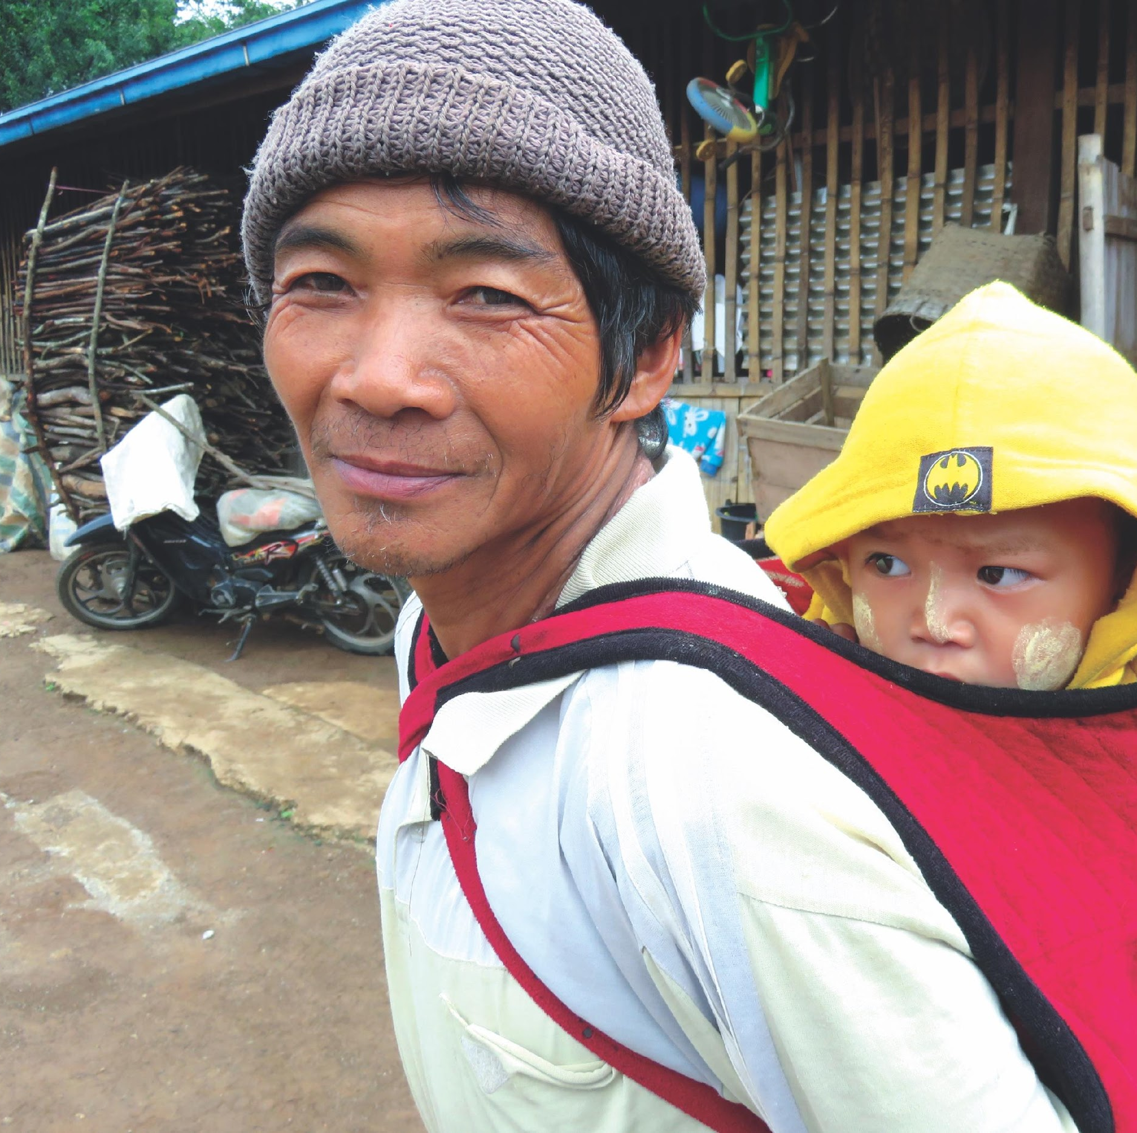
In such instances it is important to know your limitations
Are you aware of the local context?
Do you have access to goods and services they require?
How can you help someone to get what they require?
Notes:
In such instances it is important to know what your knowledge and limitations are.
Are you aware of the local context
Do you have access to goods and services they require?
How can you help someone to get what they require?

Slide 12
Providing Information
Notes:
When you are providing practical information,

Slide 13
Misinformation and rumors are common during a crisis
Notes:
It is important to avoid rumors and misinformation which is common during a crisis.

Slide 14
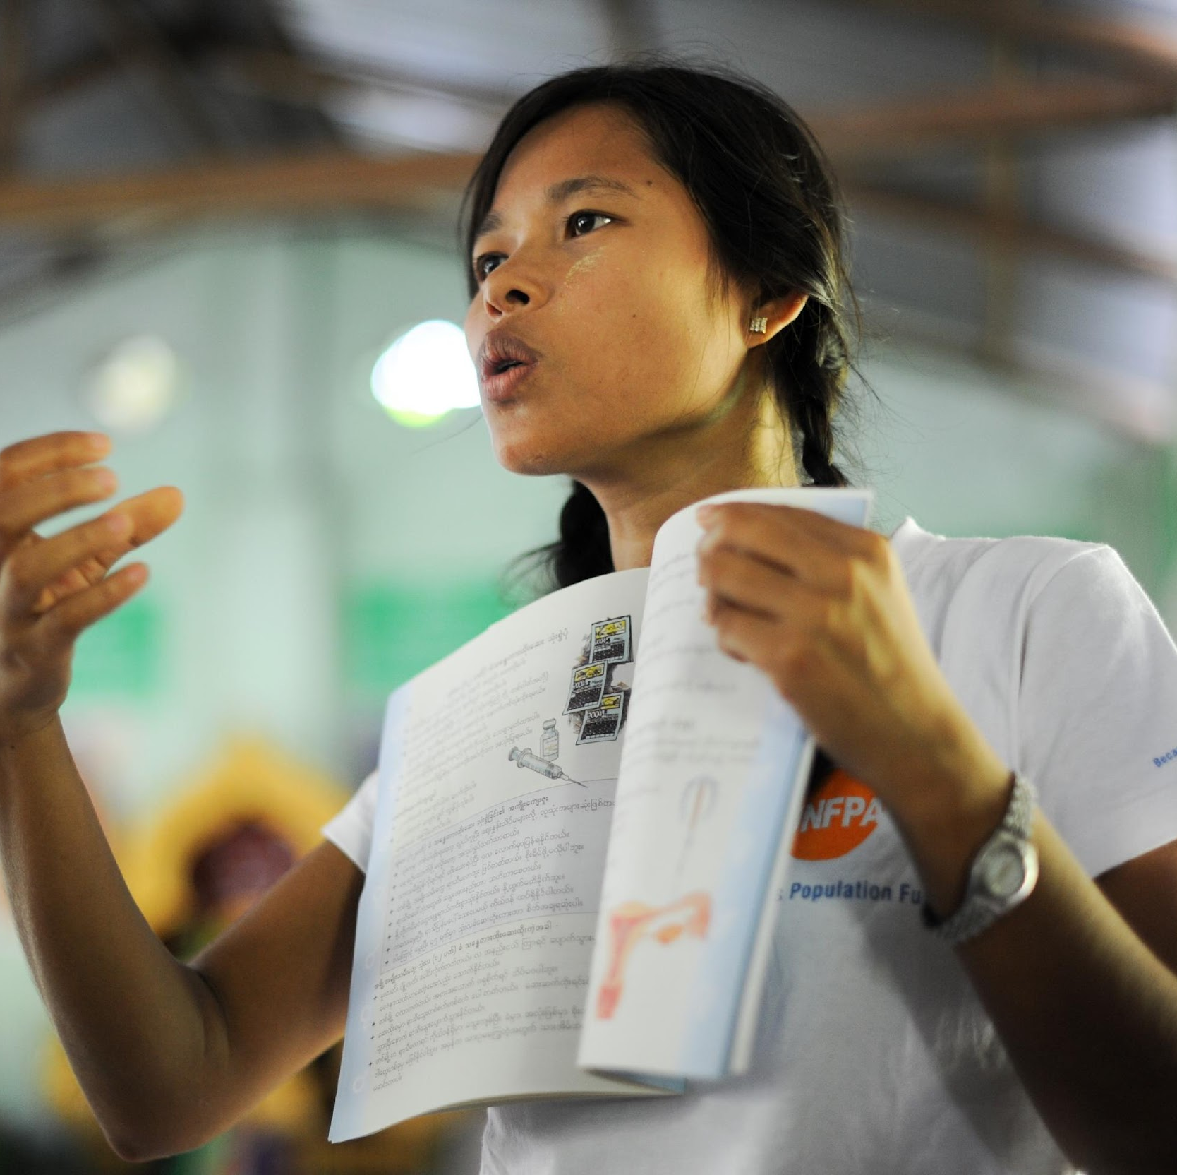
To provide clear and Accurate information
Use clear, concise language that will be easily understood. Be sure to use words that are age and developmentally appropriate. Avoid any jargon or technical language. Make sure your information is reliable and trusted.
Notes:
Therefore, the information provided should be clear and accurate by using clear, concise language that will be easily understood.
Be sure to use words that are age and developmentally appropriate. Avoid any jargon or technical language.

Slide 15
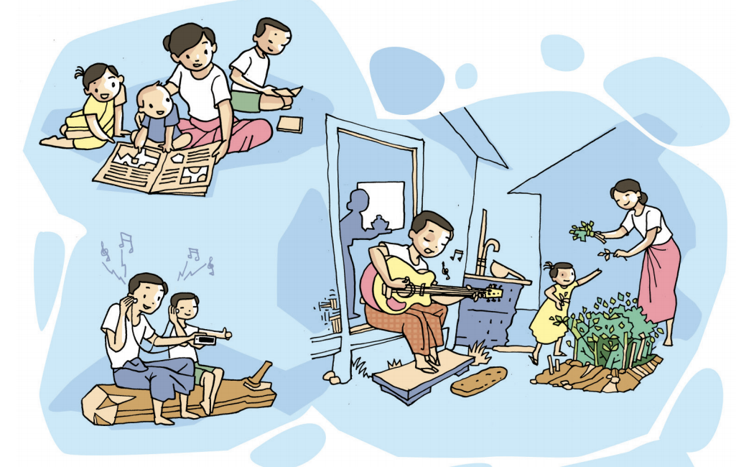
Try to have written materials in relevant languages with visual aids.
Notes:
Try to have written materials in relevant languages with visual aids

Slide 16
When needed, have a translator present.
Notes:
In addition, when needed, have a translator present.

Slide 17
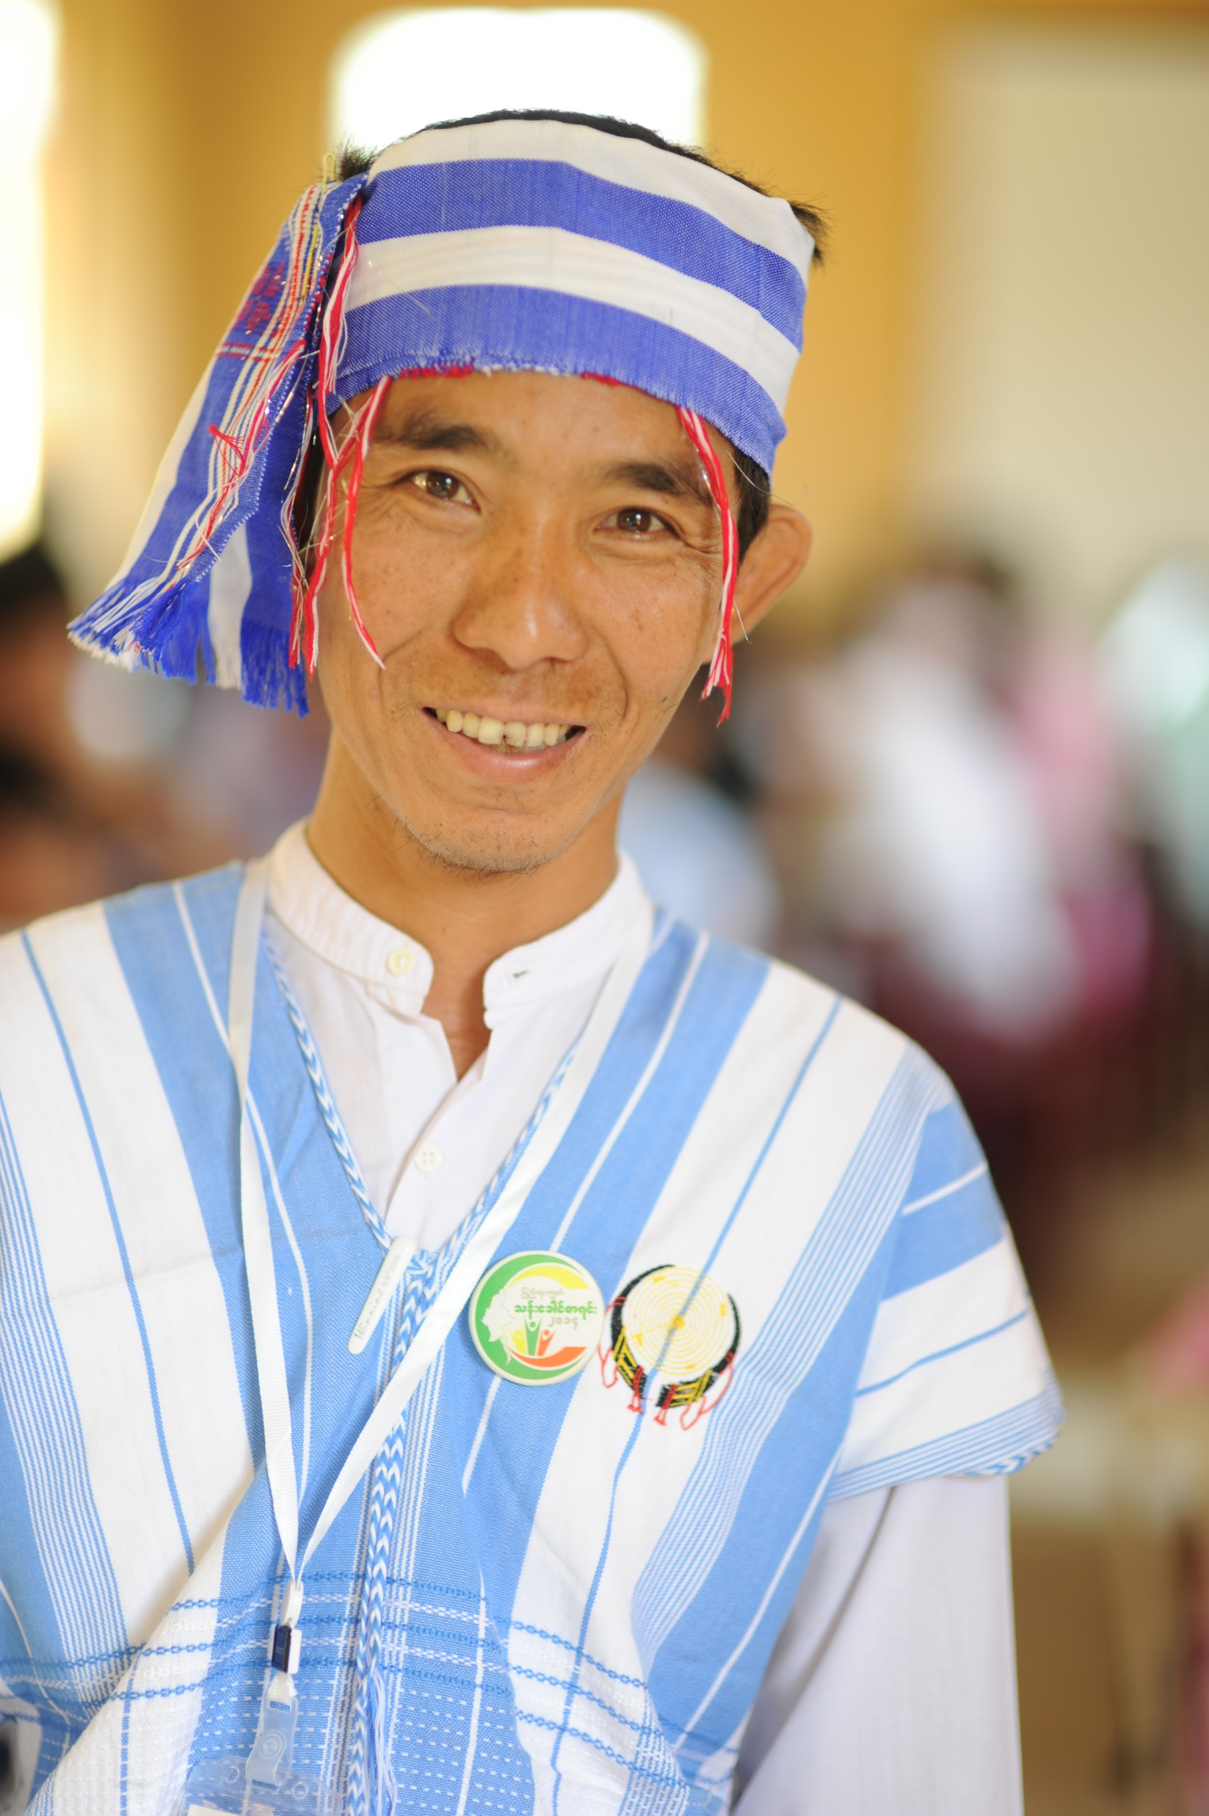
If you do not know something, be honest about this rather than trying to guess.
Notes:
On the other hand, if you do not know something, be honest about this rather than trying to guess

Slide 18
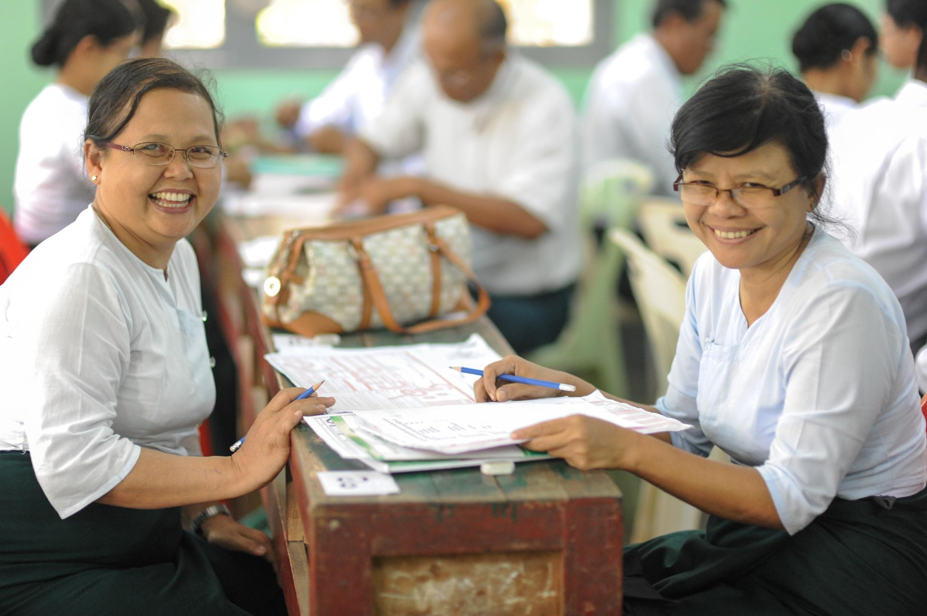
Keep yourself updated on local information as crises situations rapidly change.
Notes:
Moreover, keep yourself updated on local information as crises situations rapidly change with time.

Slide 19
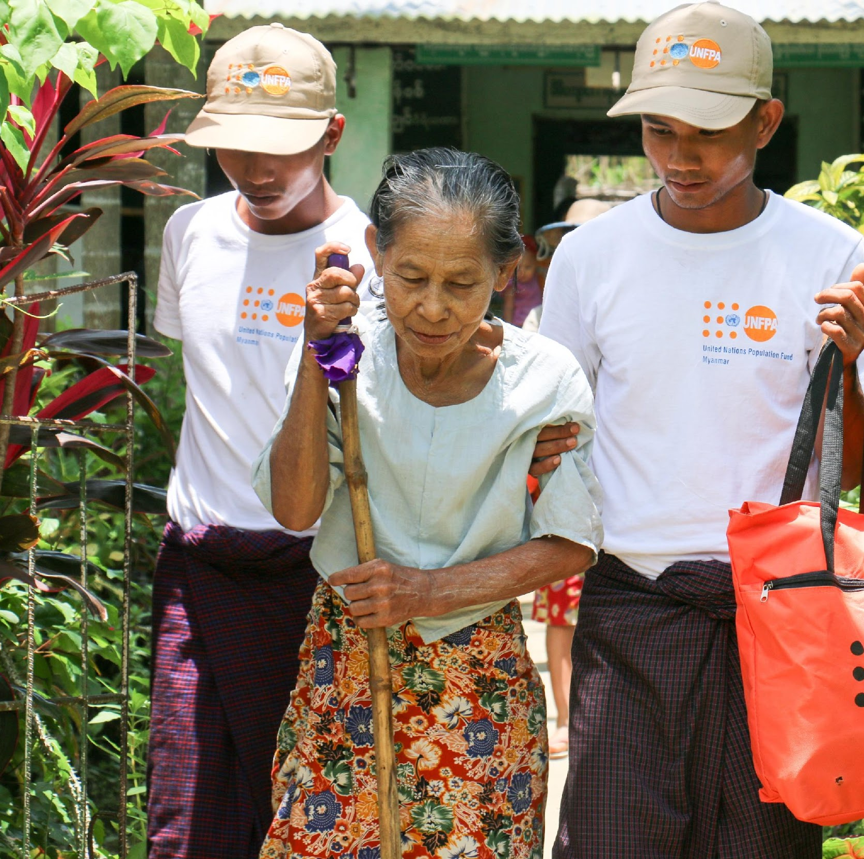
Providing basic Items or Services
Notes:
And when providing basic items or services:

Slide 20
You may be able to offer basic items or services yourself, like food, water or going shopping for others. However, don’t feel that you have to provide all these.
Notes:
You may be able to offer basic items or services yourself, like food, water or going shopping for others. However, don’t feel that you have to provide all these.

Slide 21
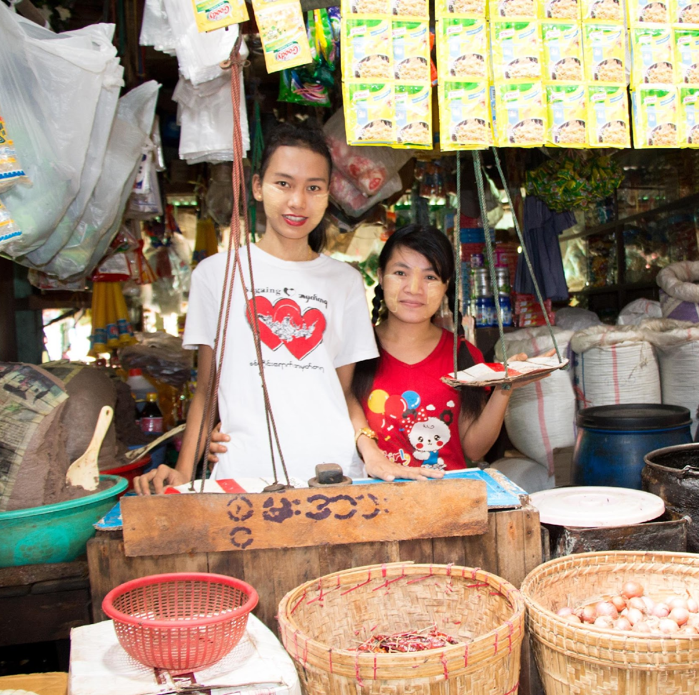
Be aware of what is possible for you and what is not.
Verify the materials with them before you buy the items
Notes:
Keep in mind, similar to information, services also require you to
Be aware of what is possible for you and what is not.
Verify the materials with them before you buy the items

Slide 22
Remember, at all times, to take the necessary precautions for your own health and safety.
Notes:
Remember at all times to take the necessary precautions for your own health and safety.

Slide 23
Module 3
3.2 Offering practical support to others
Notes:
In this video you will learn on linking people to others as a practical support

Slide 24
LINKING TO OTHERS PROVIDING PRACTICAL SUPPORT
Notes:
When you are not in a position to provide immediate practical support, it is helpful to link people to access others who are providing practical support.

Slide 25
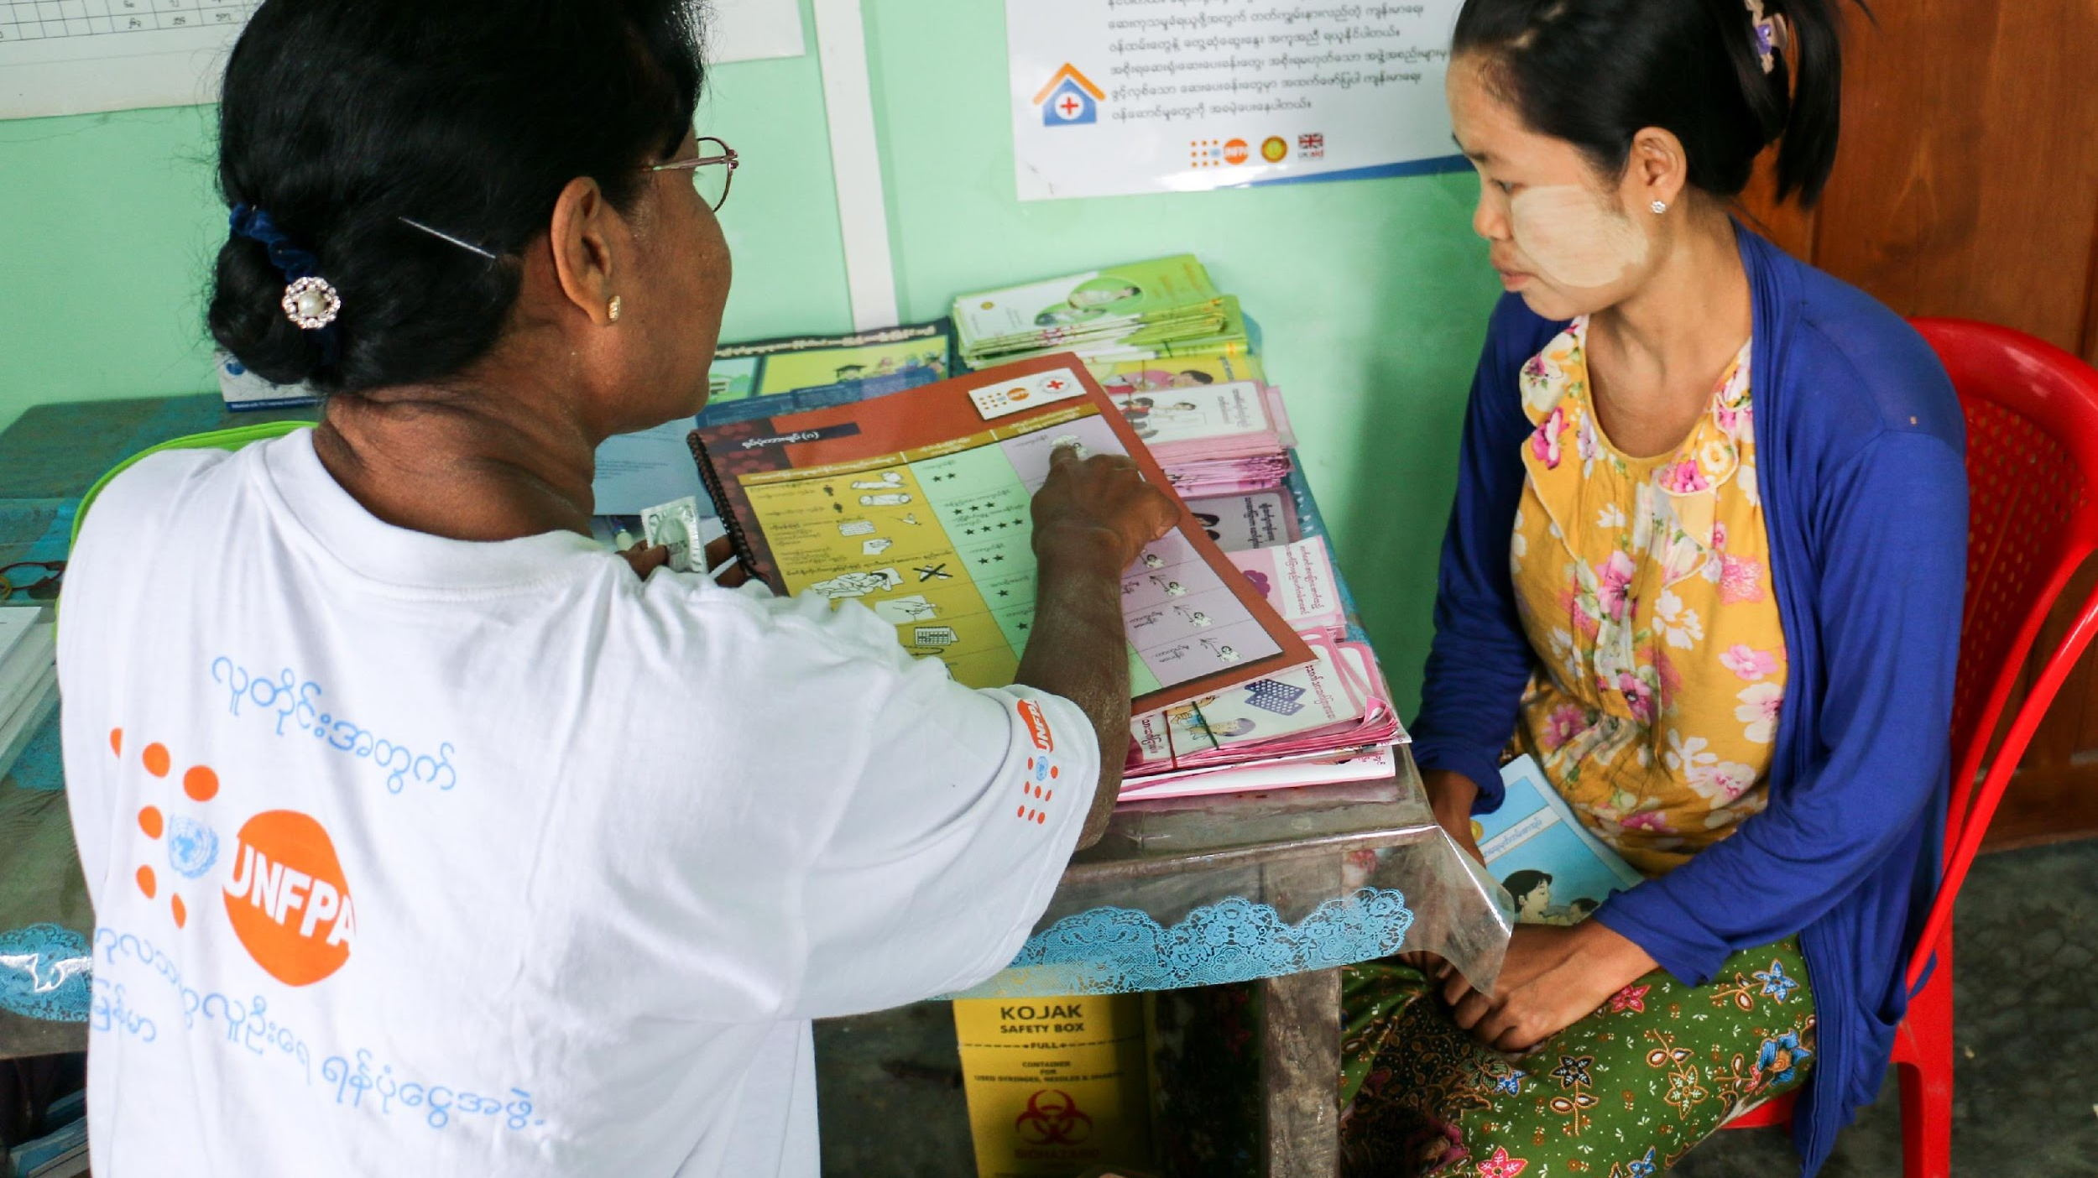
There are instances when you can’t provide the services or items needed directly, but other service providers can.
Notes:
There are instances when you can’t provide the services or items needed directly, but other service providers can fill this gap.

Slide 26
Linking people to services and supports is an essential part of helping.
Notes:
Linking people to services and supports is an essential part of helping

Slide 27
To link effectively, make a list of all the organizations operating in your area and how to access them.
Notes:
And to link effectively, make a list of all the organizations operating in your area and how to access them.

Slide 28
IDENTIFY
Identify their social support (e.g.: family, friends & neighbors)
Identify local service providers (e.g.: Non Governmental Organizations, Community based organizations and religious organizations etc.)
Notes:
To successfully link people to other practical support,
Firstly, Identify their social support (e.g.: family, friends & neighbors)
Identify local service providers (e.g.: (e.g.: Non Governmental Organizations, Community based organizations and religious organizations etc.)

Slide 29
ASK
Ask them whether they would prefer going to the identified resource for support
Ask the identified resources person or organization
Notes:
Ask them whether they would prefer going to the identified resource person or organization for support
Ask the identified resources person or organization

Slide 30
LINK
Provide contact details of the identified resources
Connect identified resource to the person in distress
Notes:
And then,
Provide contact details of the identified resources
Connect identified resource to the person in distress

Slide 31
Make sure to quickly link people in distress or those who need food, water, shelter or urgent medical or social services to ensure their safety and protection.
Notes:
Make sure to quickly link people in distress to the supporting services or individuals. When linking people who need urgent food, water, shelter, medical or social services keep in mind to ensure their safety and protection.

Slide 32
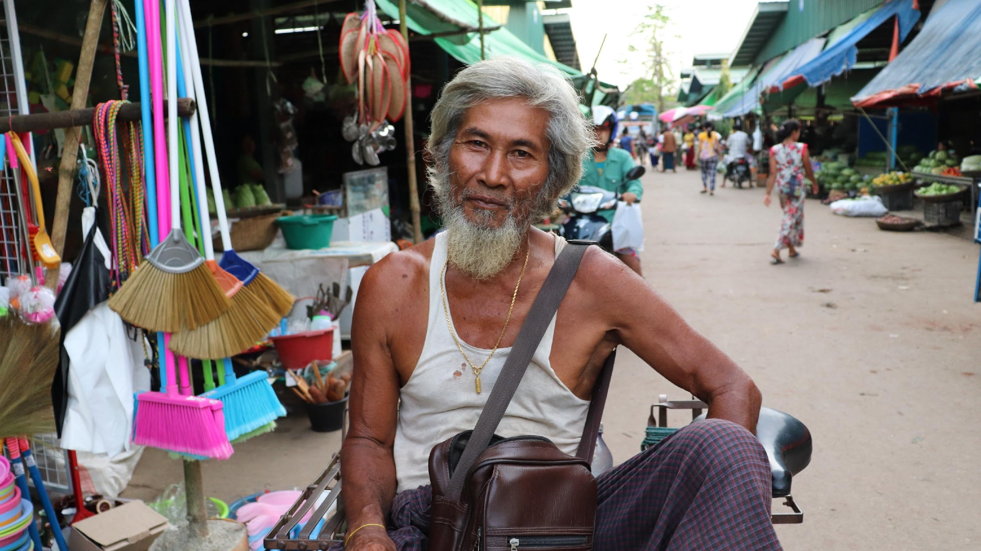
Follow up with people if you agree to do so!
Notes:
Once the linking is made, it is important to follow up with people to ensure they received the support they needed.

Slide 33
Module 3
3.3 Offering Practical Support : Helping others to help themselves

Slide 34
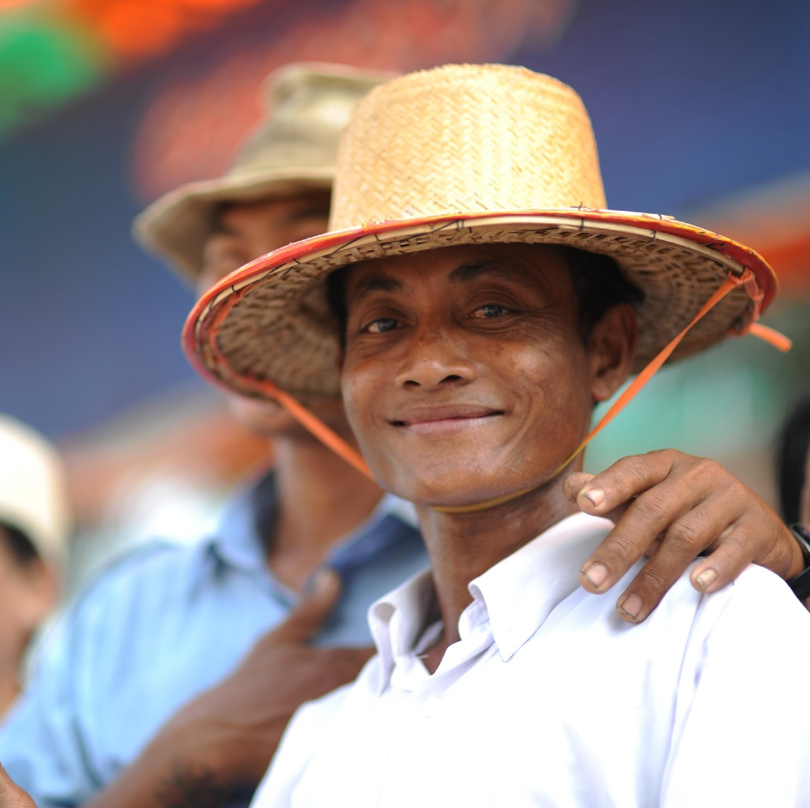
Helping others to help themselves
Notes:
When offering practical support, you can also help people to help themselves.

Slide 35
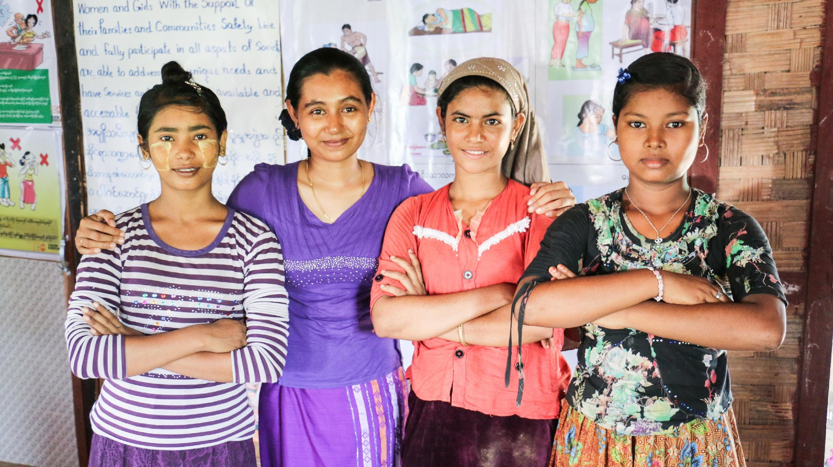
For people to function well, they often need to feel that they have some control in their lives.
Notes:
For people to function well, they often need to feel that they have some control in their lives.

Slide 36
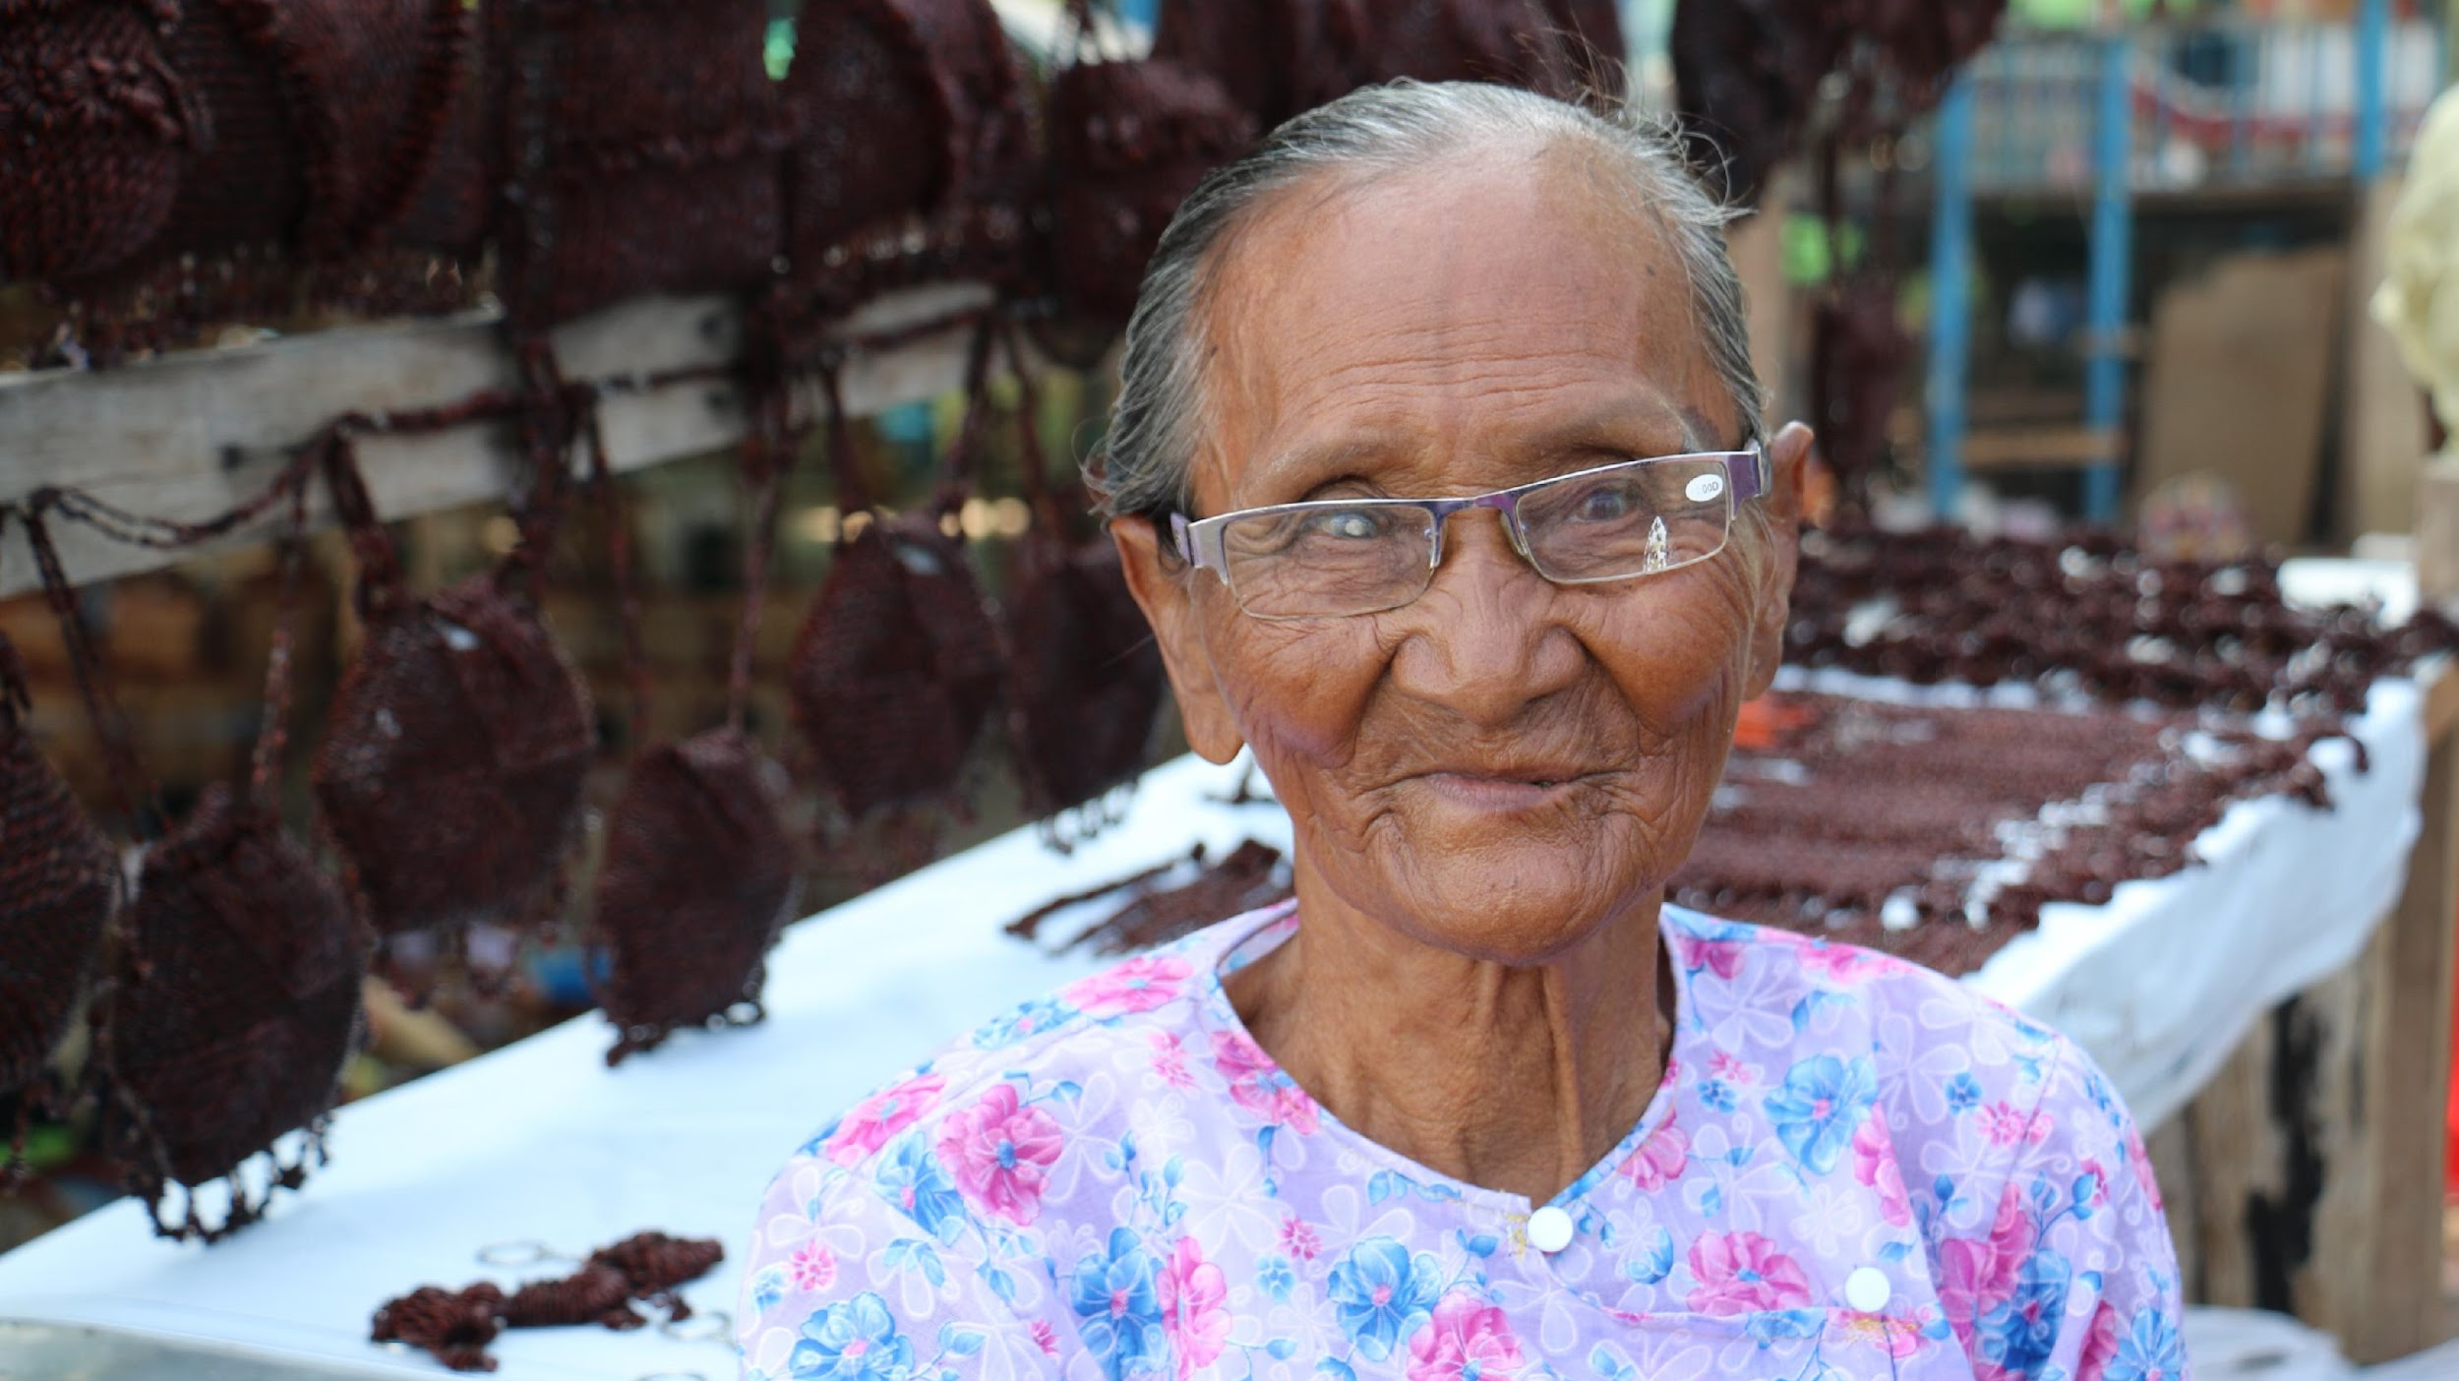
The best way to support others is to help them to help themselves.
Notes:
The best way to support others is to help them to help themselves. This will also give you more energy and time to help more people.

Slide 37
Therefore it is important to guide and accompany individuals to access information and services by themselves.
Notes:
Therefore it is important to guide and accompany individuals to access information and services by themselves.

Slide 38
Stop-Think-Go
The STOP-THINK-GO method can be used to support others to manage their own problem
Notes:
There is a method that can be used to help others help themselves.
It is called the STOP-THINK-GO method. This can be used to support others to manage their own problems.

Slide 39
Stop
Help the person to take a pause, and consider what problems are most urgent.
Help the person to use the circles of control to identify and choose a problem which they can do something about.
Notes:
In the STOP step-
You help the person to take a pause, and consider what problems are most urgent.
You can also help the person to use the circles of control, which you used in module 1, to identify and choose a problem which they can do something about.

Slide 40
Think
What have you done in the past to overcome problems like this?
What have you already tried doing?
Is there someone who can help with managing this problem (e.g. friends, loved ones or organizations)?
Do other people you know have similar problems? How have they managed?
Notes:
In the THINK step,
Encourage the person to think of ways to manage the identified problem.
The following questions may help:
What have you done in the past to overcome problems like this?
What have you already tried doing?
Is there someone who can help with managing this problem (e.g. friends, loved ones or organizations)?
Do other people you know have similar problems? How have they managed?

Slide 41
Go
Help the person to choose a way to manage the identified problem and try it out.
If it doesn’t work, encourage the person to try another solution.
You could also accompany the person to access additional resource if needed
Notes:
GO is the last step in helping others help themselves.
Here you Help the person to choose a way to manage the identified problem and try it out.
If it doesn’t work, encourage the person to try another solution.
You could also accompany the person to access additional resource if needed

Slide 42
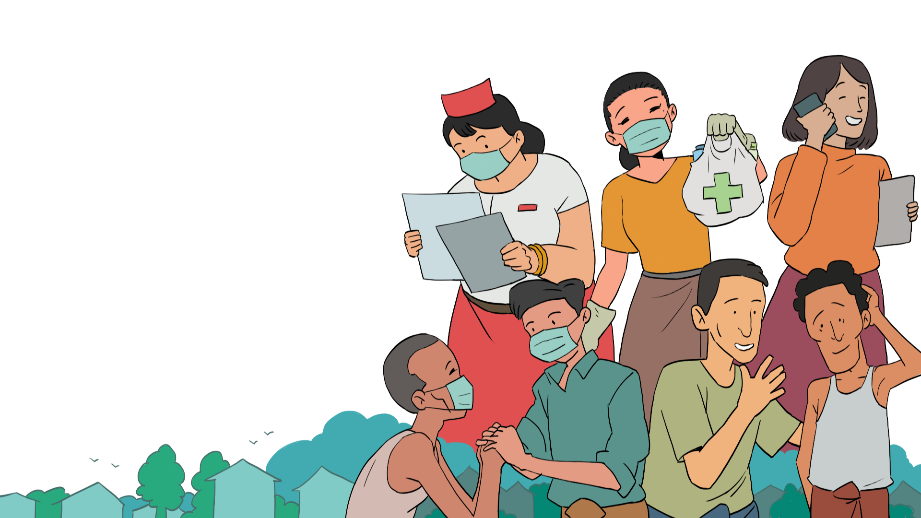
Case Study
Basic Psychosocial Skills +
Notes:
Case Study

Slide 43
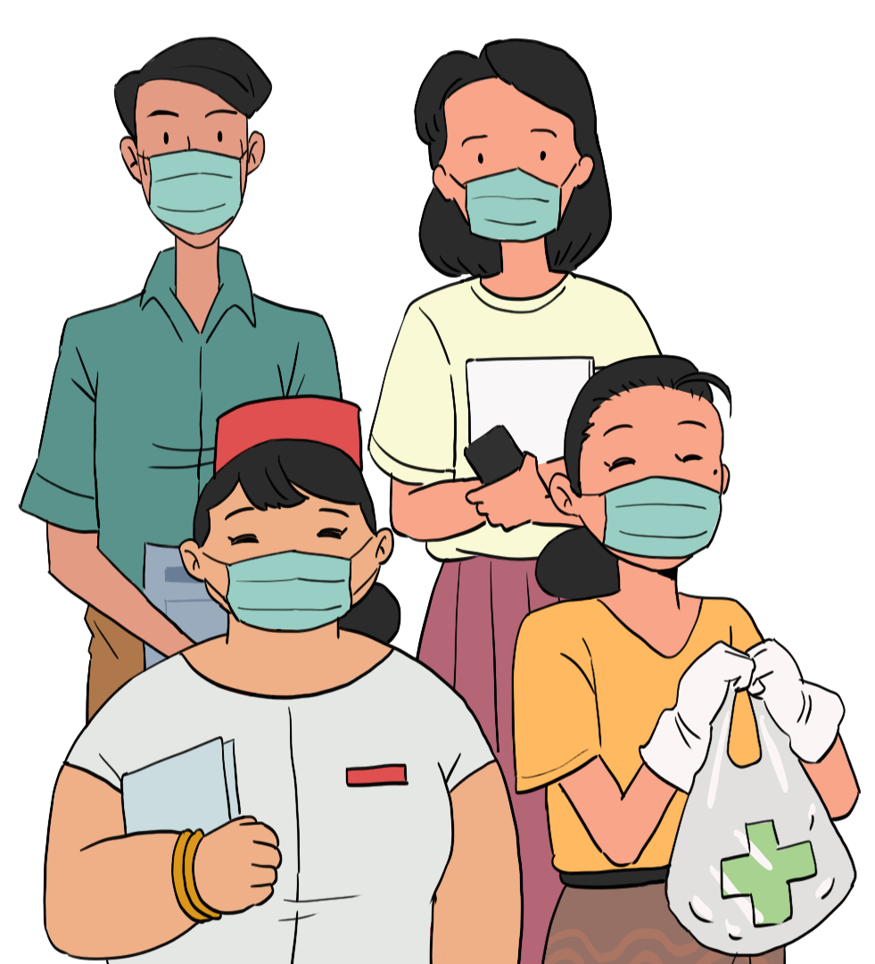
Pasaw’s case illustrates what has been discussed so far in module three how to support people affected by crisis situations by addressing thor basic and particular needs.
Notes:
Pasaw’s case illustrates what has been discussed so far in module three how to support people affected by crisis situations by addressing thor basic and particular needs.

Slide 44
Notes:
Pasaw is a counsellor, who works in a crowded community. one of the residents, Aung Bo, is an elderly man who lives by himself during the Covid-19 pandemic. Pasaw telephones him and asks how he is doing. Aung Bo says he has not been able to get outside to buy the medicine he normally takes for his hypertension.
Pasaw suggests that she could go to the pharmacy and buy Aung Bo’s medicine when she goes to the shops to buy food. They decide on a safe place just outside Aung Bo's door where he can leave money and prescription and Pasaw can leave the medicine. In that way, they do not have to come into physical contact with each other. Pasaw ensures that she wears her mask and gloves when buying and delivering the medicines to Aung Bo.

Slide 45
Case Study
Basic Psychosocial Skills +
Notes:
Case Study

Slide 46
Let’s look at how Mo Nyo is supporting to use the Stop-Think-Go method.
Notes:
Lets look at how Mo Nyo is supporting to use the Stop-Think-Go method.

Slide 47
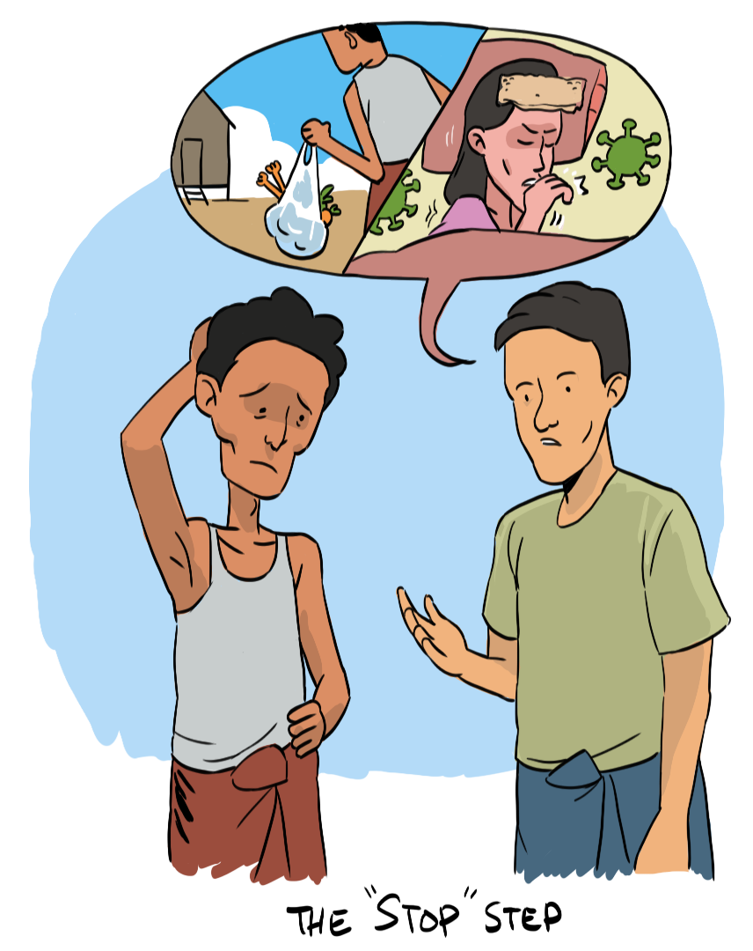
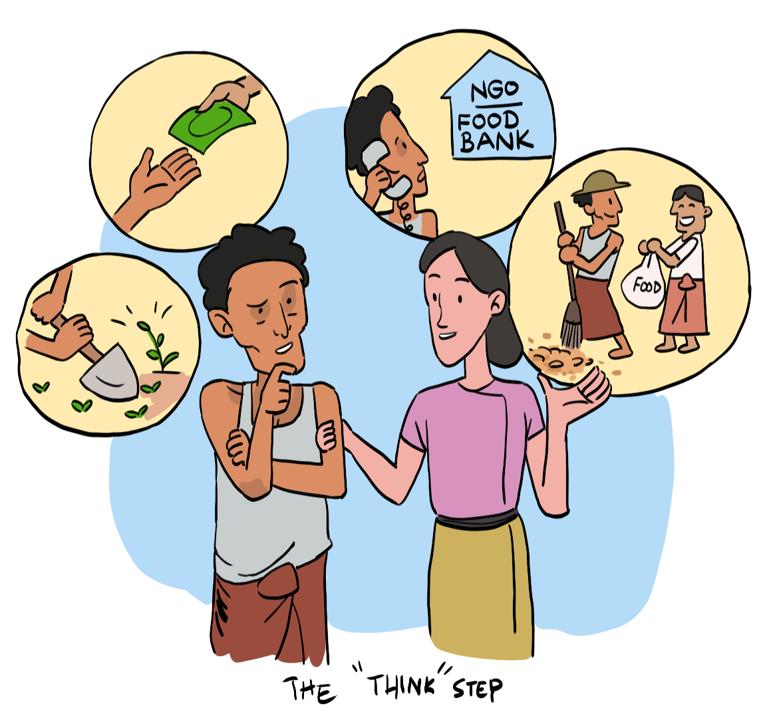
Notes:
Zaw Win seems to be overwhelmed by his problems. Mo Nyo is supporting him.
The STOP step: Mo Nyo helps Zaw Win to identify his two most urgent problems. He repeats them to check that he has understood: “Worries about feeding your family and worried about your wife contracting COVID-19”. ”. To help Zaw Win choose one problem, Mo Nyo asks, “Is there anything you can do about this?” Zaw Win decides that he can do something about both of his problems. He decides, however, that feeding his family is the first priority.
The THINK step: Mo Nyo asks Zaw Win to think of all the possible ways to feed his family.
He tells him that he can suggest any solutions, even if they are silly or unrealistic. Zaw Win struggles to begin with, so he talks with his wife, who helps him think of solutions. Together, they think of the following options:
Beg for food / Begin growing their own food / Contact a local NGO or food bank / Offer to exchange food with neighbours in return for his work.

Slide 48
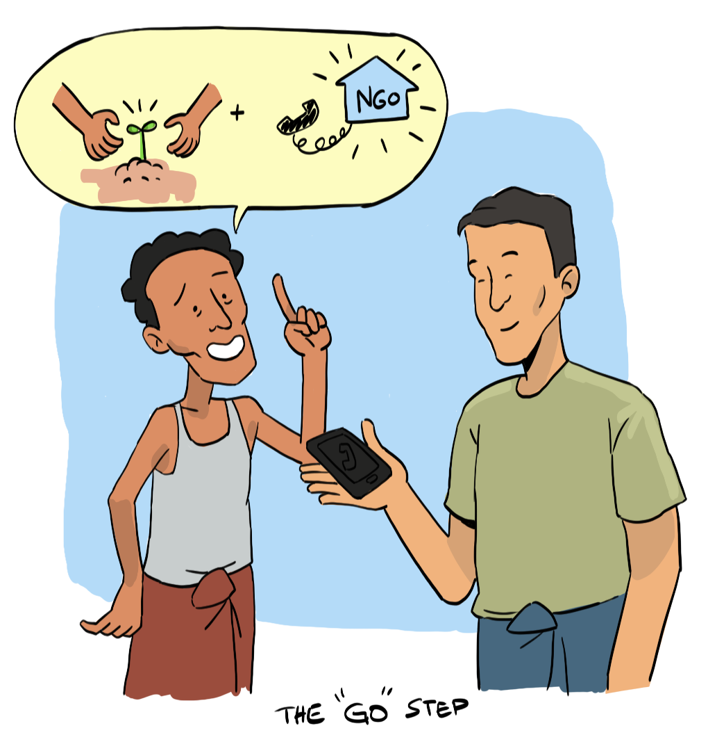
Notes:
In the GO step: Mo Nyo asks Zaw Win to choose one solution from the list to try out. Zaw Win has some seeds and would like to grow his own food; however, this will take time.
Begging for food could put Zaw Win at increased risk of infection. Zaw Win decides to contact a local NGO for food immediately and to begin growing some vegetables in his garden for the future. If he cannot get food help from the NGO, then he will come back to the list of solutions. Mo Nyo gives Zaw Win the NGO’s number to call them.

Slide 49
Module 3 Complete
Next: Module 4
Notes:
Thank you! You have completed module 3 of Basic Psychosocial skills for first responders in Myanmar. In this module we discussed ‘Helping People in Specific Situations’. We have looked at what kinds of needs people will have during a crisis situation and how you can offer practical support as a frontline worker.
We hope you have enjoyed this module. Please take the evaluation for module 3 and then continue to module 4

